Slide 1



Slide 2




15+ Years
100+ Countries
60,000+ Businesses

Slide 3
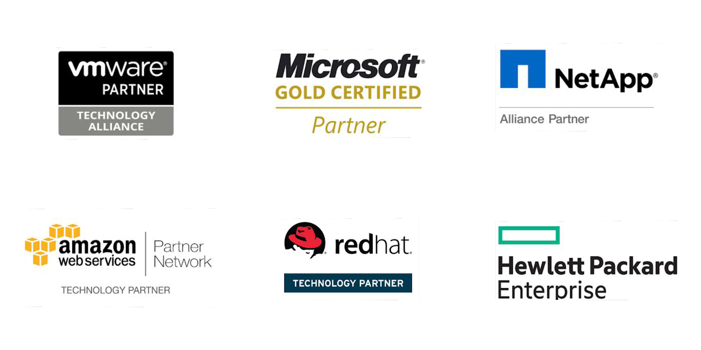
Vembu
Technology Partner
Backup & Disaster Recovery

Slide 4
Vembu Cloud BDR Suite
Product Overview

Slide 5










Vembu Cloud BDR Suite
Vembu Cloud Services is a simple and cost-effective backup solution for small and mid-sized businesses. Users can protect their data residing in physical and virtual environments directly to Vembu Cloud
Cloud Backup for File Servers
Cloud Backup for Endpoints
Cloud Backup for Applications
Cloud Backup
for Microsoft 365
Cloud Backup
for Google Workspace
(Coming Soon)
(Coming Soon)
(Coming Soon)
(Coming Soon)
Cloud Backup
for VMware
Cloud Backup
for Hyper-V
Cloud Backup
for Microsoft Windows
Cloud Backup for AWS

Slide 6
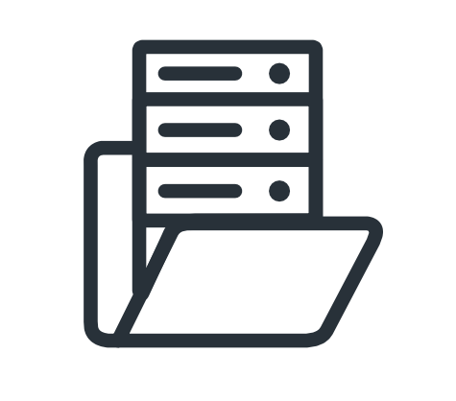


File & Application Backup for Windows, Linux & Mac
Backup for File Servers
Backup for Endpoints
Vembu Cloud Backup for File Servers helps to protect your data across file servers of Windows, Linux with enterprise-level functionality.
Continuous Data Protection
Flexible Retention policies
Interruption-free Backup
Vembu Cloud Backup for Endpoints ensures protection to critical data across your Windows & Mac platforms at granular level.
High Backup Data Compression Ratio
Restore backup data anywhere anytime
Pre/Post Commands support
Backup for Applications
Vembu Cloud Backup for Applications enhances the data protection of your application servers, by backing up the application items granularly.
Backup MS Exchange, SQL, SharePoint, Outlook and MySQL
Highly secured Encryption and Compression
Restore automatically into the application

Slide 7


Backup for SaaS Applications
Backup for Microsoft 365
Backup for Google Workspace
Vembu Cloud Backup for Google Workspace is an effective solution that ensures protection of emails, contacts, calendar, & G- drives by backing up to the Vembu Cloud.
Backup your entire Domain or select users manually
Data is secured over flight and at rest
Retain multiple copies of G-Drive files and retrieve them as you wish
Search and view the emails of the backed-up user accounts
Detailed and reliable backup and recovery reports
Vembu Cloud Backup for Microsoft 365 is an robust solution that protects emails, contacts, calendar, & one drive of Microsoft 365 by directly backing up to Vembu Cloud.
Backup Entire Domain or Specific User Data
Recover Entire Mailbox or Individual Mails
Export to multiple formats like .PST, .EML, .VCF, .ICF, etc...
Restore OneDrive Business Folders with Folder Structure
Restore backup data either to same user or to different user account

Slide 8




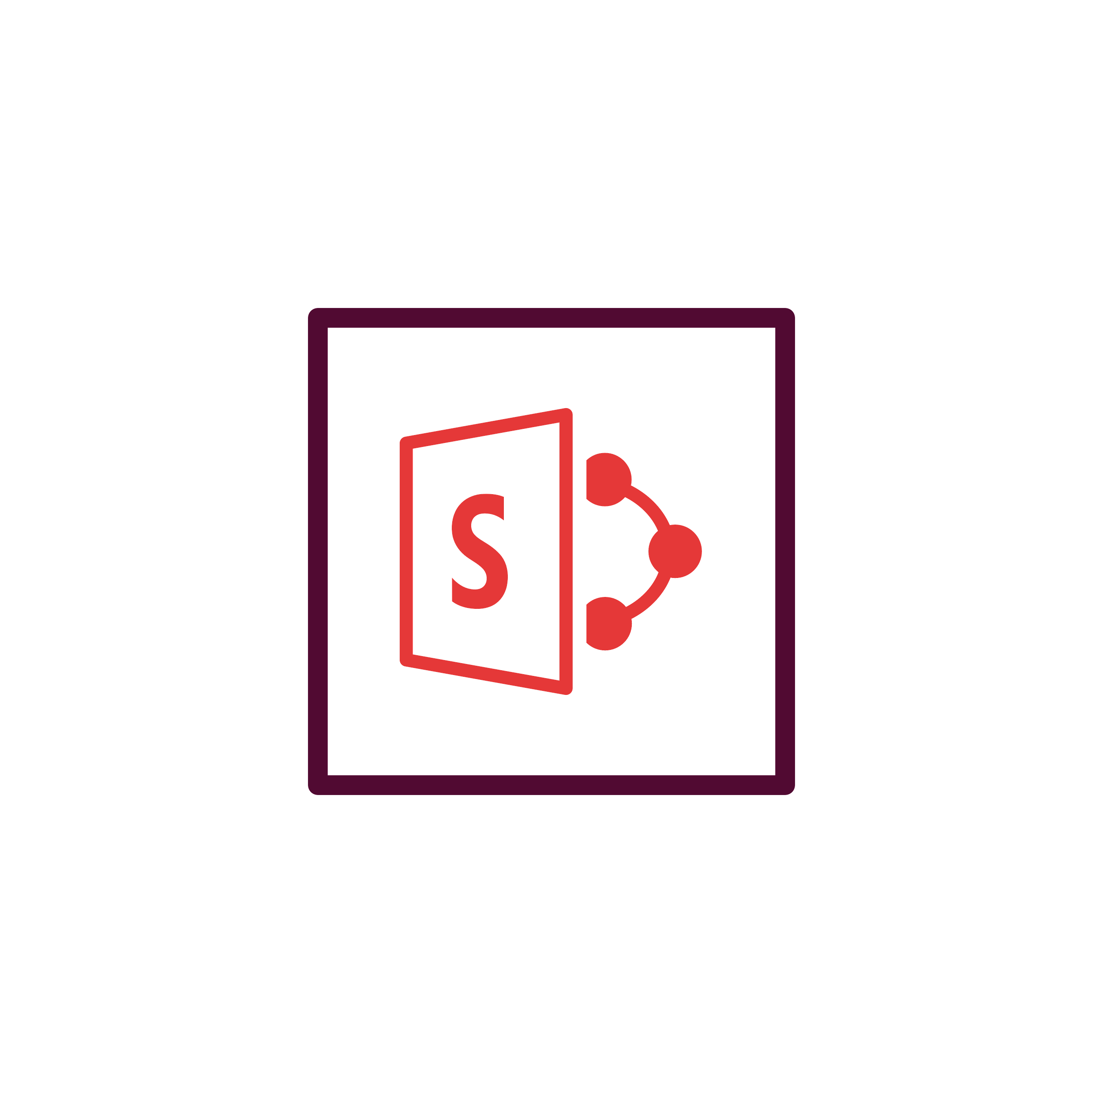







Vembu Portal
(For Licensing)
Vembu Cloud BDR Architecture
File Servers /Endpoints / Applications
Vembu Cloud BDR
Suite
Microsoft 365
Google Workspace
Backup & Disaster Recovery

Slide 9
Vembu Cloud BDR Suite
Key features

Slide 10





Key Features of Vembu Cloud BDR Suite
Continuous Data Protection
Network Drive Backup
Effortless Restore
Direct Application Restore
Vembu Cloud BDR Suite offers continuous and near continuous data protection with incremental backups.
Map and backup the files and folders of the network drive to Vembu Cloud directly.
Login to your Vembu Cloud BDR Suite console and restore all your backup data from anywhere at any time.
Restore the backed up MS Exchange, SQL or Outlook data into the respective MS application or to a local disk automatically.

Slide 11

Vembu Cloud BDR Suite Licensing

Slide 12


File Servers
Endpoints
Applications
Cloud Backup for
File Servers, Endpoints & Applications
Windows & Linux Servers
Windows & Mac OS
(MS Exchange, SQL, SharePoint, Outlook & MySQL)
Subscription License
$24 +
Cloud Storage Fee
$6 +
Cloud Storage Fee
$24 +
Cloud Storage Fee
(Includes product updates, upgrades & standard technical support until subscription period)
per server/annum
per endpoint/annum
per application/annum
Cloud Storage Fee
100 GB *
$144
per 100 GB/annum
* The Vembu Cloud storage is available as a 100 GB package. Depending on your storage needs, you can buy multiples of 100 GB packages.
Backup & Disaster Recovery

Slide 13
Microsoft 365
Cloud Backup for
Microsoft 365
Subscription License
$12 + Cloud Storage Fee
(Includes product updates, upgrades & standard technical support until subscription period)
per User/annum
Cloud Storage Fee
100 GB *
$144
per 100 GB/annum
* The Vembu Cloud storage is available as a 100 GB package. Depending on your storage needs, you can buy multiples of 100 GB packages.
Backup & Disaster Recovery

Slide 14
Google Workspace
Cloud Backup for
Google Workspace
Subscription License
$12 + Cloud Storage Fee
(Includes product updates, upgrades & standard technical support until subscription period)
per User/annum
Cloud Storage Fee
100 GB *
$144
per 100 GB/annum
* The Vembu Cloud storage is available as a 100 GB package. Depending on your storage needs, you can buy multiples of 100 GB packages.
Backup & Disaster Recovery

Slide 15
Thank You
USA & CANADA
+1-512-256-8699
UNITED KINGDOM
+44-203-793-8668
Email
vembu-sales@vembu.com
vembu-support@vembu.com

