Slide 1



Slide 2




15+ Years
100+ Countries
60,000+ Businesses

Slide 3
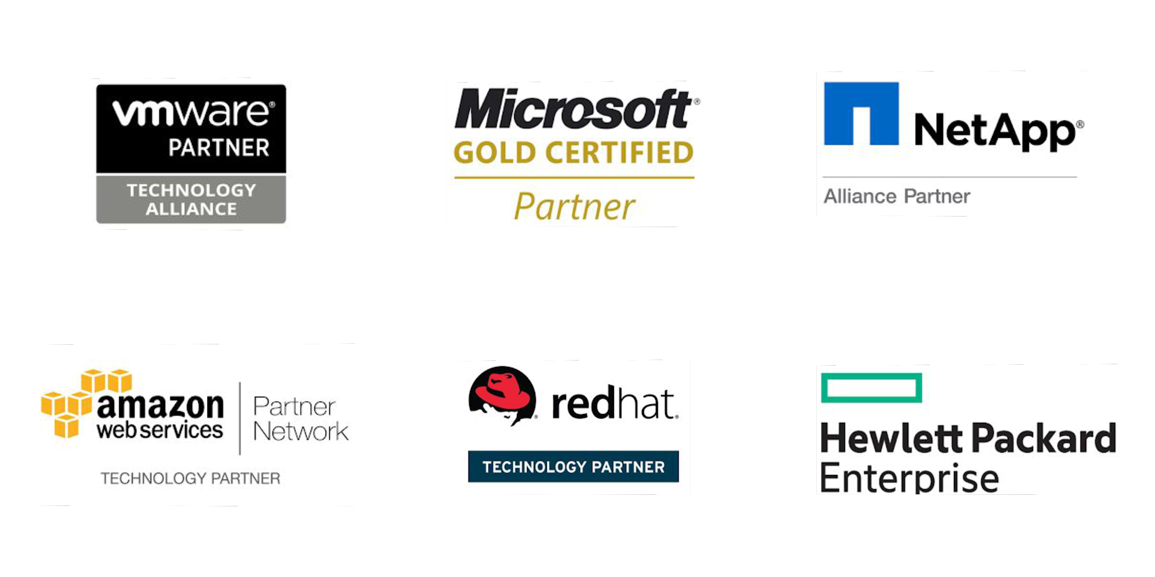
Vembu
Technology Partner

Slide 4
Vembu BDR Suite
Product Overview

Slide 5










Vembu BDR Suite
Vembu BDR Suite is a portfolio of products designed to backup multiple environments from
virtual to physical to cloud while addressing diverse and advanced use cases
Backup & Replication for VMware
Backup & Replication for Hyper-V
Backup for
Microsoft Windows
Backup for AWS
Backup for
Microsoft 365
Backup for
Google Workspace
Backup for
File Servers
Backup for Endpoints
Backup for
Applications

Slide 6
Vembu Backup for AWS

Slide 7

Vembu Backup for AWS ensures agentless backup and restores of any EC2 Instances through AWS APIs, it is done by launching a Vembu BDR Backup Server instance in your AWS Account using the Vembu CloudFormation template. All the target instances’ snapshots (restore points) will be stored in the same account from which they are backed up.
Near-Continuous Data Protection with automatic scheduling
Ensures Application-Aware backups
Instance and Volume-level recovery
Backup for
AWS
Backup & Disaster Recovery

Slide 8
Vembu BDR Suite
Deployment

Slide 9


Ideal setup for businesses looking to manage backups for their premises either it may be a large one or a small environment.
Setup BDR Backup Server in your local environment and backup via WAN
Configure and manage backup jobs from BDR Backup Server GUI
All the target instances’ snapshots (restore points) will be stored in the same account from which they are backed up.
On-premise Deployment - Simple
Vembu BDR Backup Server
AWS EC2 instance
Backup & Disaster Recovery

Slide 10
Vembu BDR Suite
Key features

Slide 11







Key Features for AWS Backup
Agentless Cloud-Native Backup
Automatic Backup Scheduling
Application-Aware Processing
Vembu BDR Suite uses cloud-native AWS APIs to ensure agentless backup for EC2 instances running on any region.
Experience near-continuous Data Protection of your instances by scheduling backups on a minute, hourly, daily or weekly basis.
Vembu Backup for AWS ensures to backup only when the application writers are stable and guarantees a transaction-consistent snapshot.
Pre/Post Backup Scripts
Instance Recovery
Volume Recovery
Run the customized scripts directly before or after a backup job to prepare the applications to be in a consistent state.
Recover backup instances from the required restore point by registering a new AMI Image that you can either deregister after recovery or leave registered to create future instances.
Recover only the required volumes by attaching them to target instances by configuring the capacity, volume type, and the attached behavior.

Slide 12

Vembu Backup for AWS
Licensing Model

Slide 13
Licensing
Subscription
Available Editions
Vembu offers licensing options at monthly & yearly subscriptions
24/7 support and major/minor upgrades included
Free
Standard
Perpetual
Free Edition - AWS Backup
One time purchase with upgrades and support free for one year
After 1 year AMC of 20% of license fee to be paid for continued support & updates
Backup upto 10 AWS EC2 instances for free without feature restrictions using Free Edition of Vembu Backup for AWS.

Slide 14

AWS Instance
Backup for
AWS
Subscription License
$30
(Includes product updates, upgrades & standard technical support until subscription period)
per Instance/ annum
Perpetual License
$75
(Free maintenance & support for 1st year)
per Instance
Backup & Disaster Recovery

Slide 15
Thank You
USA & CANADA
+1-512-256-8699
UNITED KINGDOM
+44-203-793-8668
Email
vembu-sales@vembu.com
vembu-support@vembu.com

