Slide 1



Slide 2




15+ Years
100+ Countries
60,000+ Businesses

Slide 3
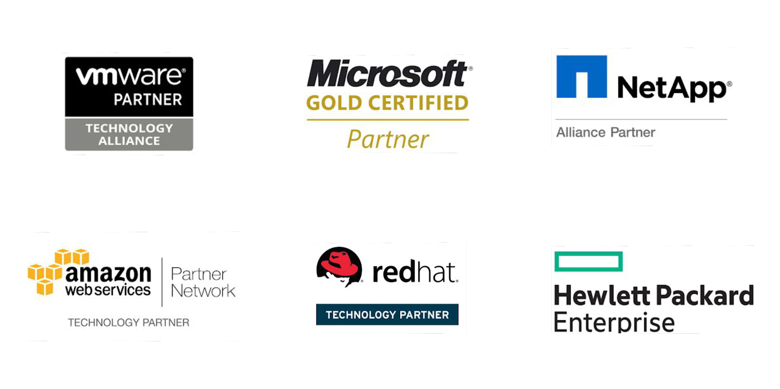
Vembu
Technology Partner

Slide 4
Vembu BDR Suite
Product Overview

Slide 5










Vembu BDR Suite
Vembu BDR Suite is a portfolio of products designed to backup multiple environments from
virtual to physical to cloud while addressing diverse and advanced use cases
Backup & Replication for VMware
Backup & Replication for Hyper-V
Backup for
Microsoft Windows
Backup for AWS
Backup for
Microsoft 365
Backup for
Google Workspace
Backup for
File Servers
Backup for Endpoints
Backup for
Applications

Slide 6
Vembu Backup for Applications

Slide 7



Vembu Backup for Applications enhances the data protection of your application servers, by backing up the application items granularly. To back up the applications, Vembu utilizes Microsoft APIs or Utility tools to dump the backup data from the application locally before transferring it to the Vembu BDR Backup Server.
Backup MS Exchange, SQL, SharePoint, Outlook and MySQL
Backup the entire application data or only the selected databases
Restore directly to the respective Microsoft application or into a local disk
Backup for
Applications
Backup & Disaster Recovery

Slide 8
Vembu BDR Suite
Deployment

Slide 9


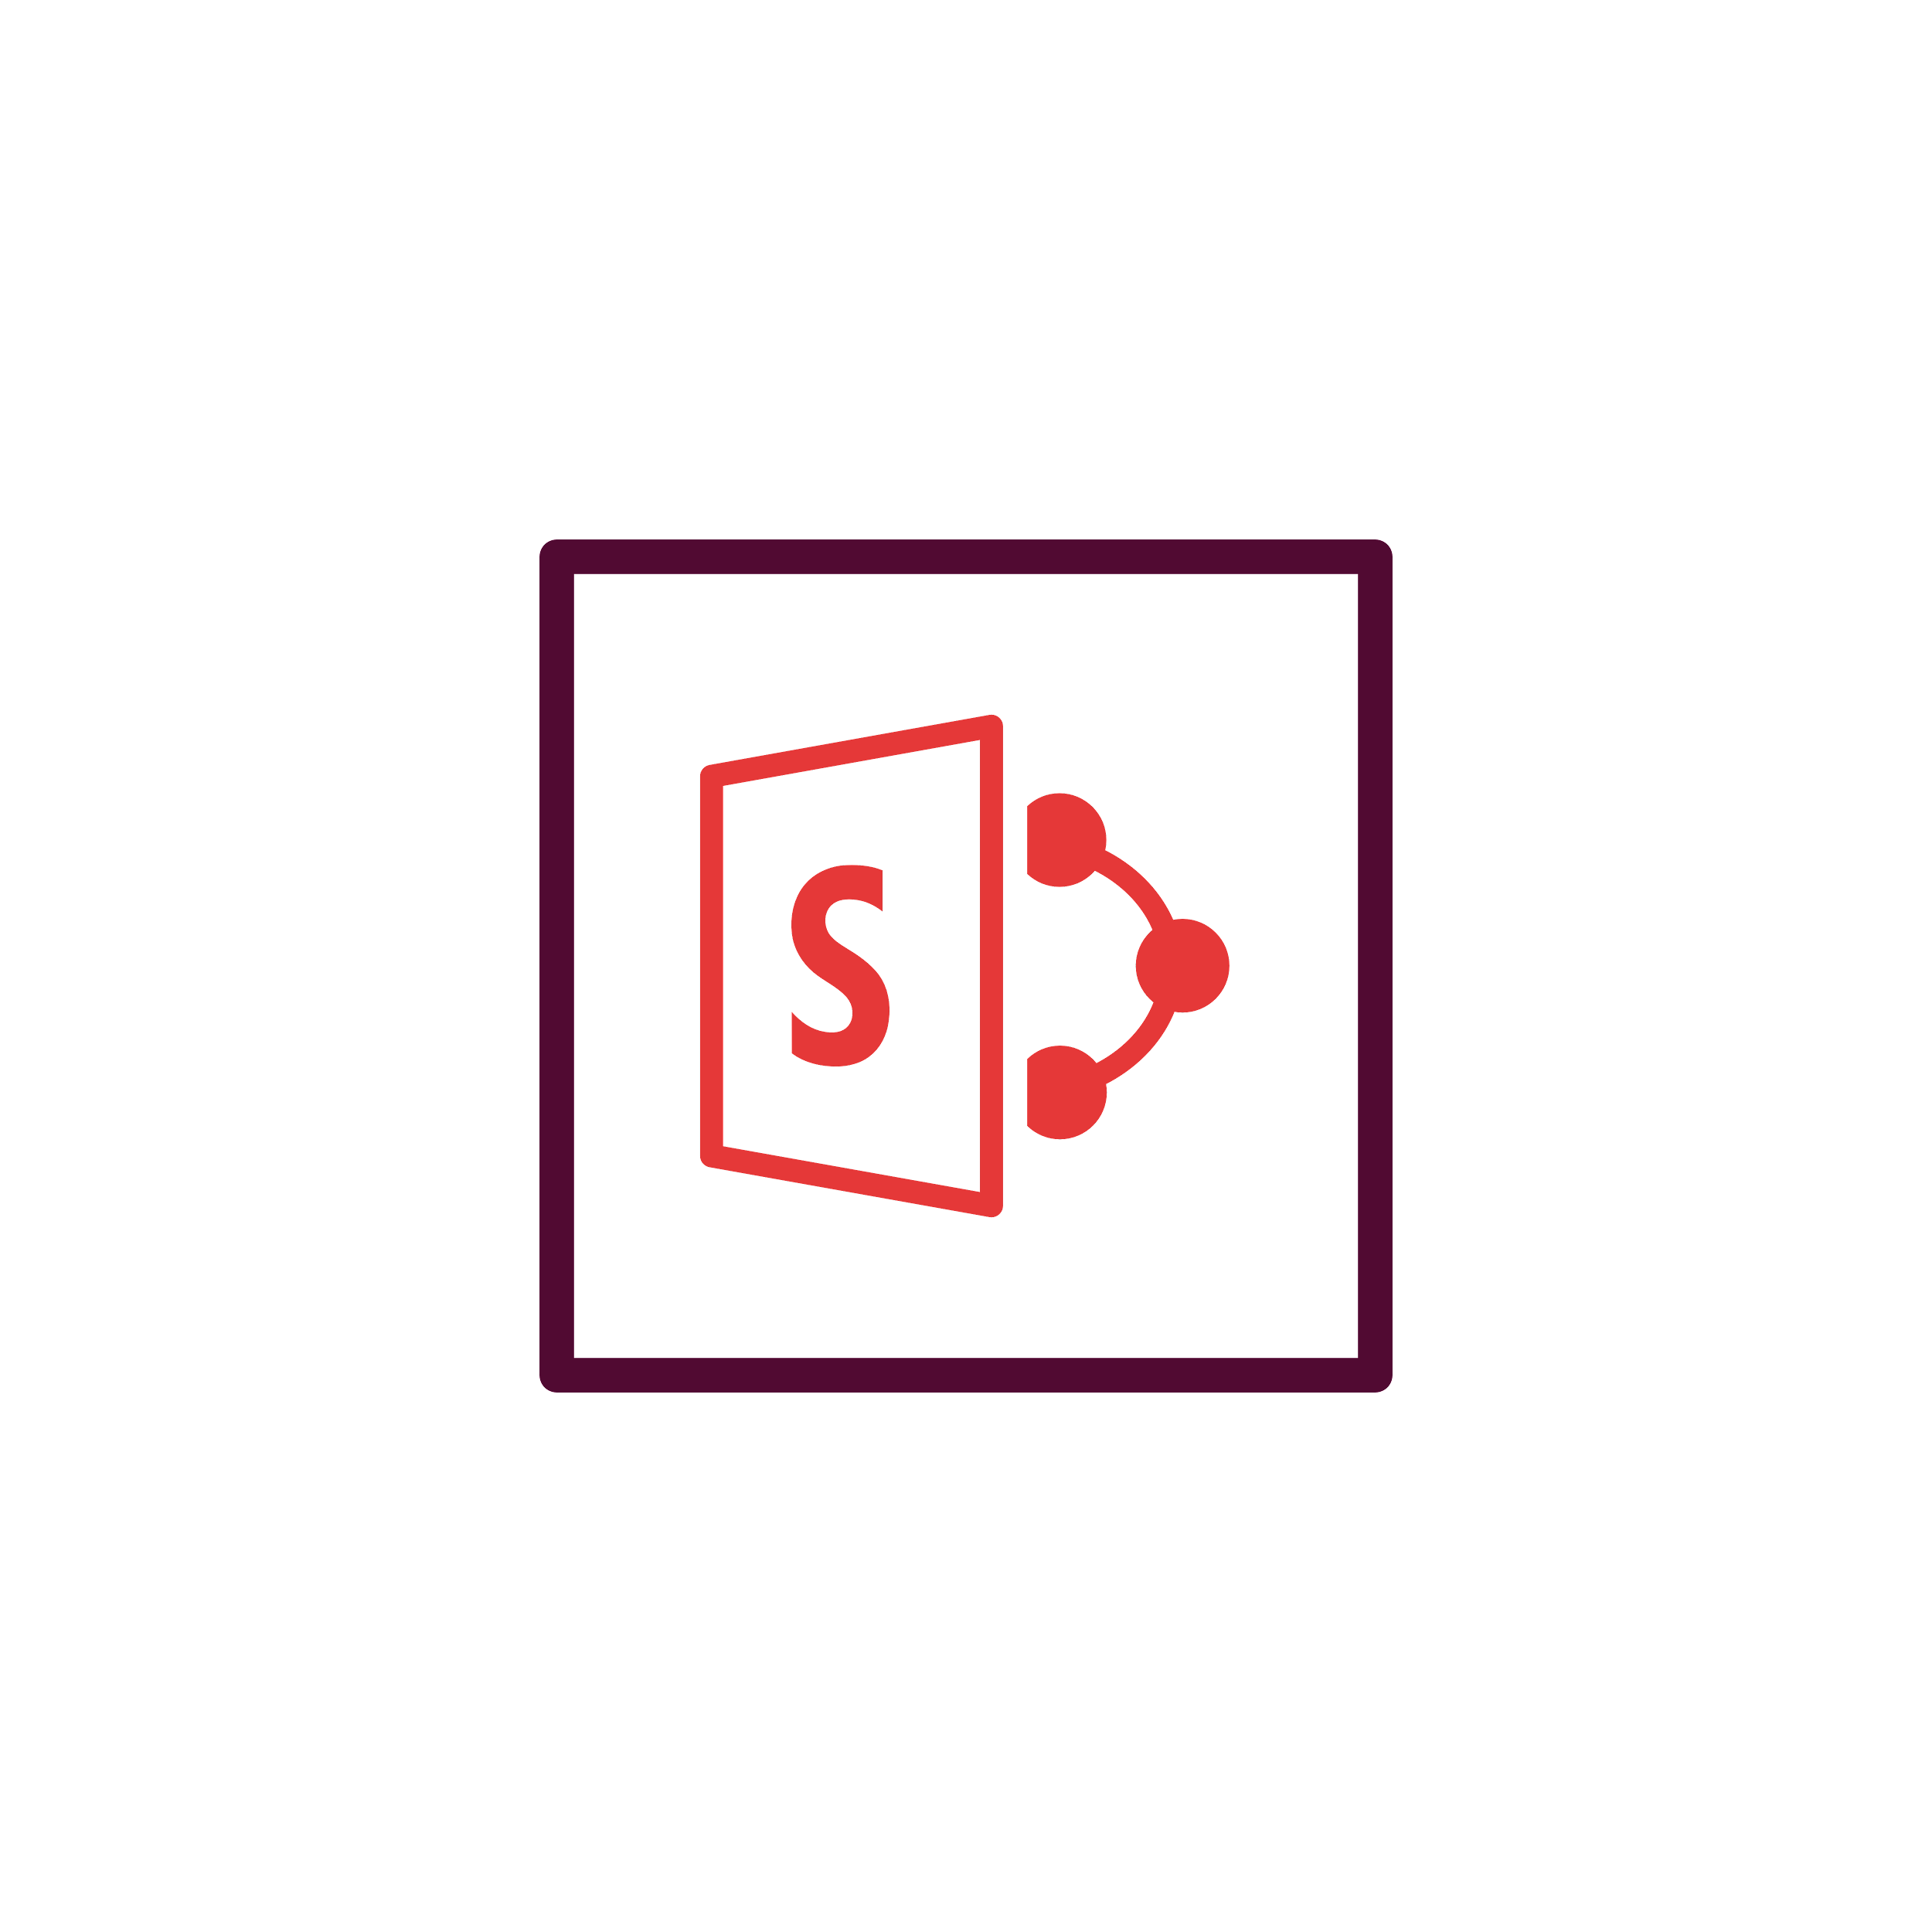

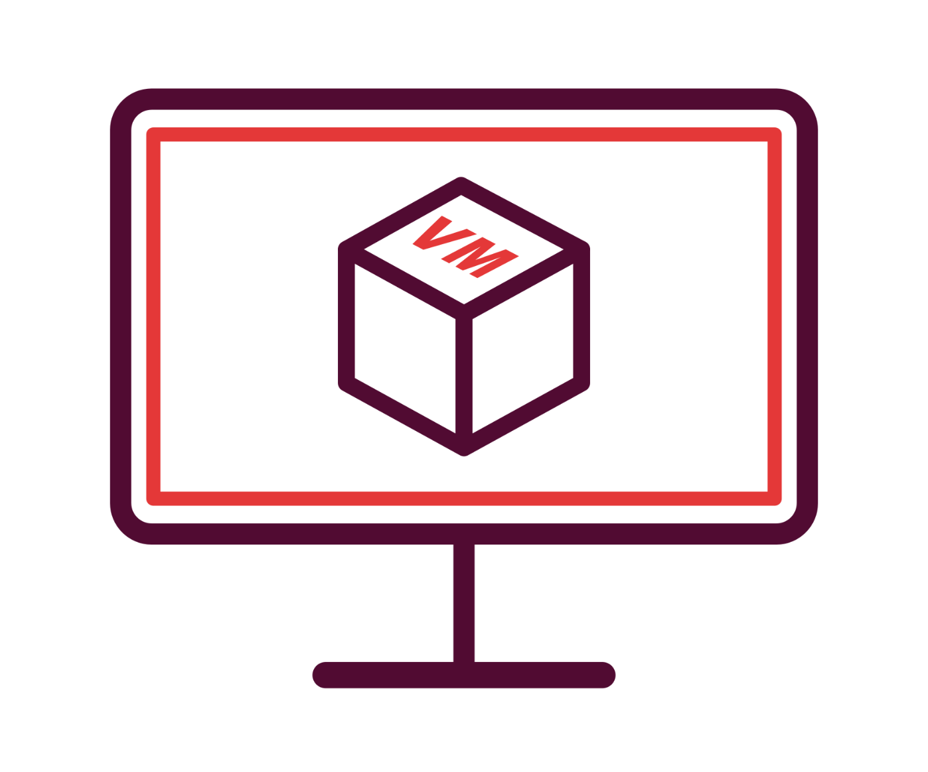



Ideal setup for businesses looking to manage backups for their premises either it may be a large one or a small environment.
Setup BDR Backup Server in your local environment and backup via LAN
Using Vembu BDR Client, backup your Windows/ Mac laptops and desktops to the storage repositories attached at the backup server end.
Configure and manage backups through the Vembu BDR Client GUI, but can restore the backup data both from the client and from the backup server.
On-premise Deployment - Simple
LAN/ WAN
Vembu BDR Client
Vembu BDR Backup Server
Backup & Disaster Recovery

Slide 10
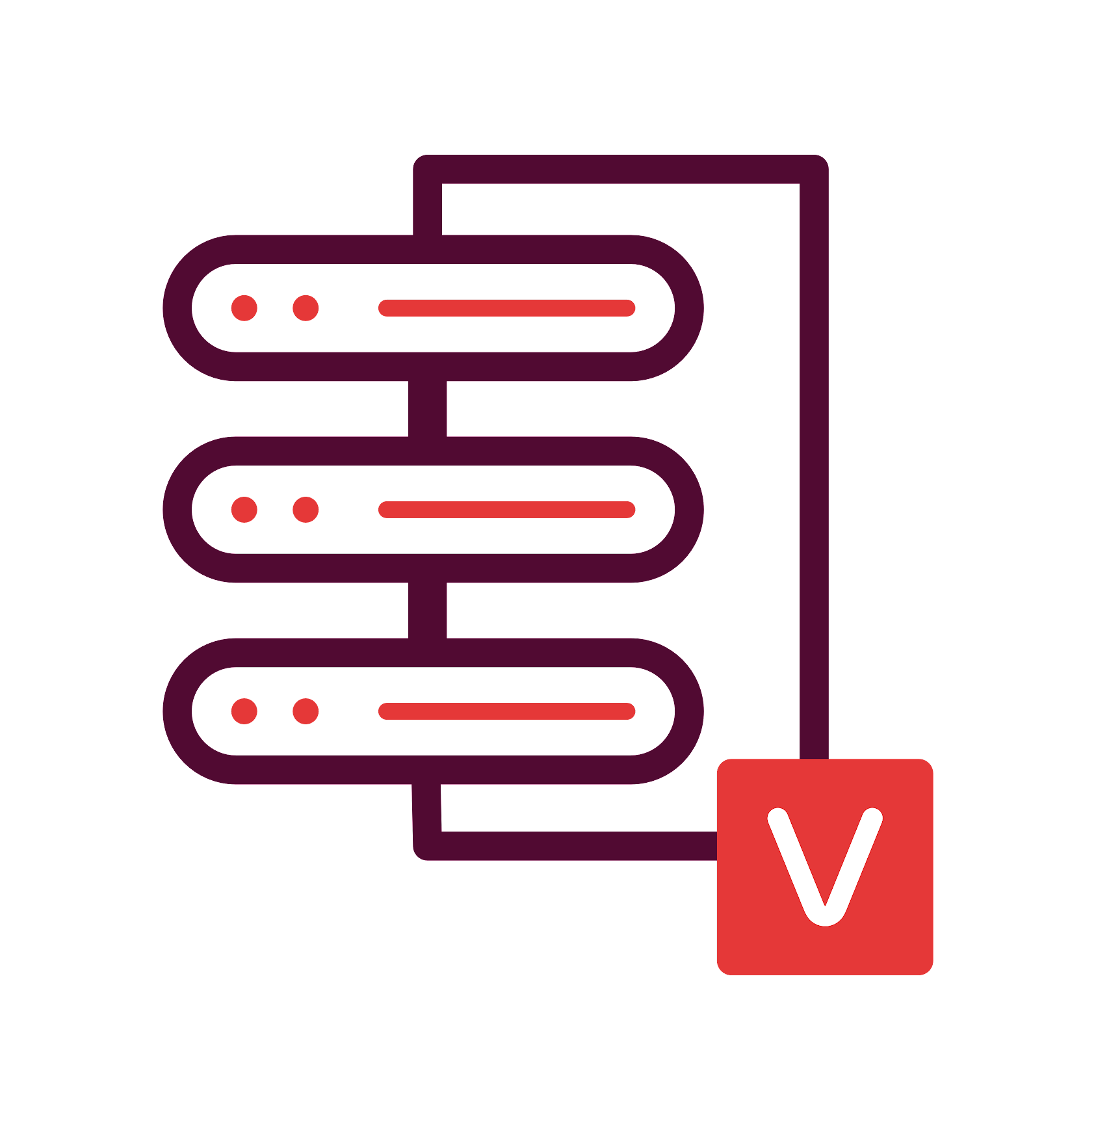
This deployment is recommended for large environments
Setup BDR Backup Server in your local environment and backup via LAN
Send a copy of backup data to your secondary datacenter via LAN/WAN
Ensure a disaster-resistant environment by installing the Vembu Offsite DR Server in your secondary datacenter
Hybrid Deployment Scenario 1 (Offsite DR)
LAN/ WAN
LAN/ WAN
Vembu BDR Backup Server
Vembu Offsite DR Server
Backup & Disaster Recovery

Slide 11
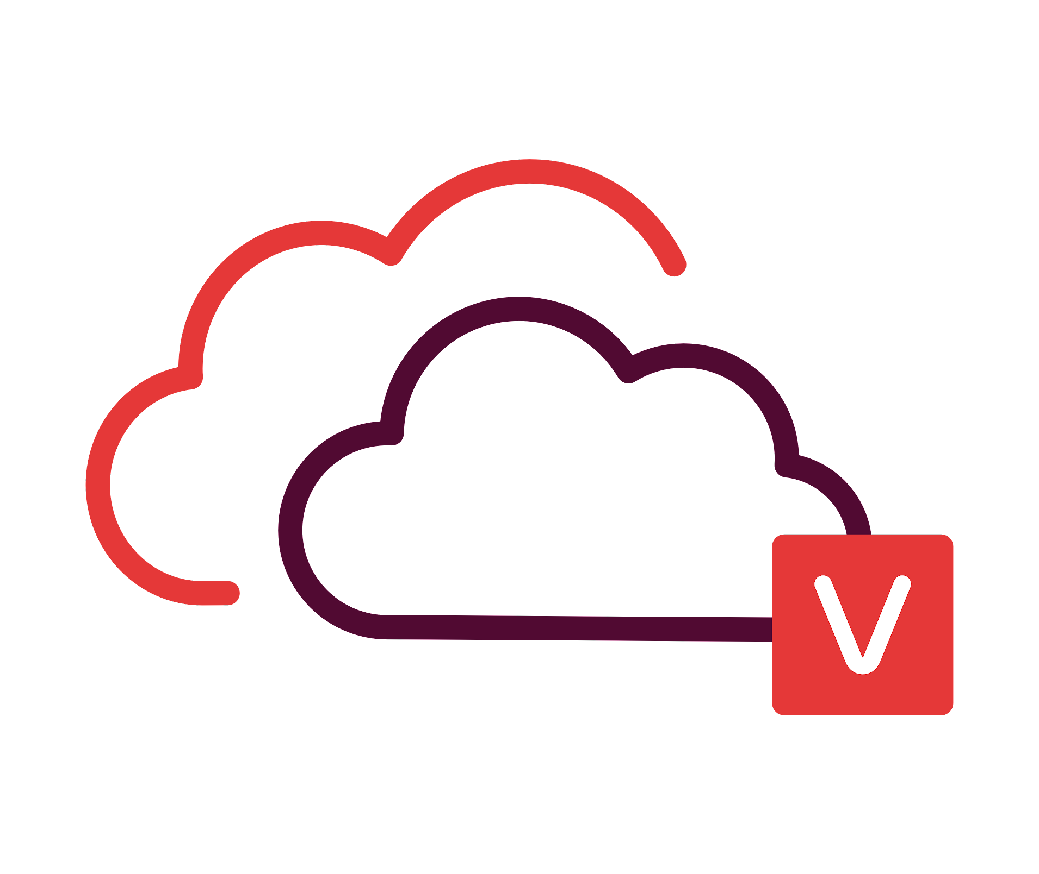
This deployment is recommended for small and medium environments
Setup BDR Backup Server in your local environment and backup via LAN
Send a copy of backup data to Vembu Cloud via WAN connection
Ensure a disaster-resistant environment by signing up for Vembu Cloud DR
Hybrid Deployment Scenario 2 (Cloud DR)
LAN/ WAN
WAN
Vembu BDR Backup Server
Vembu Cloud DR Server
Backup & Disaster Recovery

Slide 12

Cloud Service Providers can host Vembu Offsite DR Server in their data center
They can have a copy of backup data from the Vembu BDR Backup Servers to their data center over WAN
Offsite (or) Remote Deployment (CSP)
Customer Site
Cloud Service Provider - Data Center
LAN/ WAN
WAN
Vembu BDR Backup Server
Vembu Offsite DR Server
Backup & Disaster Recovery

Slide 13
Setup Vembu BDR Backup Server and Vembu Offsite DR Server in remote office as well as branch office
Sync backup data between both the locations
Remote office
Branch office
Vembu BDR Backup Server
Vembu Offsite DR Server
LAN/ WAN
Vembu BDR Backup Server
Vembu Offsite DR Server
Backup & Disaster Recovery

Slide 14
You can easily scale up the backup server when backup load increases
Backup requests will be equally shared between each backup server
Backup Server
Clustering
Vembu BDR Backup Server
Vembu BDR Backup Server
LAN/ WAN
Server Cluster
Vembu BDR Backup Server
Vembu BDR Backup Server
Backup & Disaster Recovery

Slide 15
Vembu BDR Suite
Key features

Slide 16







Key Backup Features for Applications
Microsoft Exchange Backup
Microsoft SQL Backup
Microsoft SharePoint Backup
Backup the entire MS Exchange Server or perform a folder-level backup of the mailbox by specifying the user.
Backup your MS SQL server databases and restore the required databases by specifying the recovery state.
Backup the site collections from your local machine in MS SharePoint by configuring an incremental backup schedule.
Microsoft Outlook Backup
MySQL Backup
Seed Backup
Backup your emails configured in MS Outlook profile along with the rules, at the folder level.
Perform incremental backups of your MySQL databases using utility tools to dump the data locally before transferring it to backup storage.
Transfer the full backup data from the client to the remote backup server through any secondary medium such as an external hard drive or a flash drive.

Slide 17






Important Key Features for Applications Backup
Near Continuous Data Protection
Flexible Retention Policies
Restore Anywhere
Flexible backup schedules based on your requirement, can run backup schedules on Daily/Weekly/Once/Monthly.
Retain any number of backup versions of full backups or incremental backups separately to ensure the data availability.
Instantly restore the entire backup granularly either from the client end or at the backup server end.
Restore to Application Server
Backup Schedule Window
Email Notification
Restore backups of MS Exchange, SQL, or Outlook data directly to the respective Microsoft application or into a local disk.
Set the time frame to suspend your backups for a certain period, once the schedule limit ends, the backups will resume automatically.
Enable email notifications to get alerts on the actual status of the configured backups (like success, failure, missed).

Slide 18






Other Key Features of Applications Backup
Efficient Storage Management
Compression
End-to-End Encryption
Vembu BDR Backup Server utilizes VembuHIVE™ file system to effectively manage storage repositories..
Built-in compression and deduplication to reduce the storage space with the ability to scale as & when required.
The backup data is encrypted using the AES-256 bit algorithm to protect the data both in flight and at rest.
Drive Rotation
Where it left off
Reporting
It helps you to use multiple external hard drives to store the backup data and swap them on a regular basis.
Even if there is a network failure or other interruptions during backup, the backup will automatically restart from where it left off during the previous schedule
Users can manage all their backups with Backup Status Reports, Restore Reports, etc...

Slide 19
Vembu BDR Suite
Disaster Recovery Scenarios

Slide 20
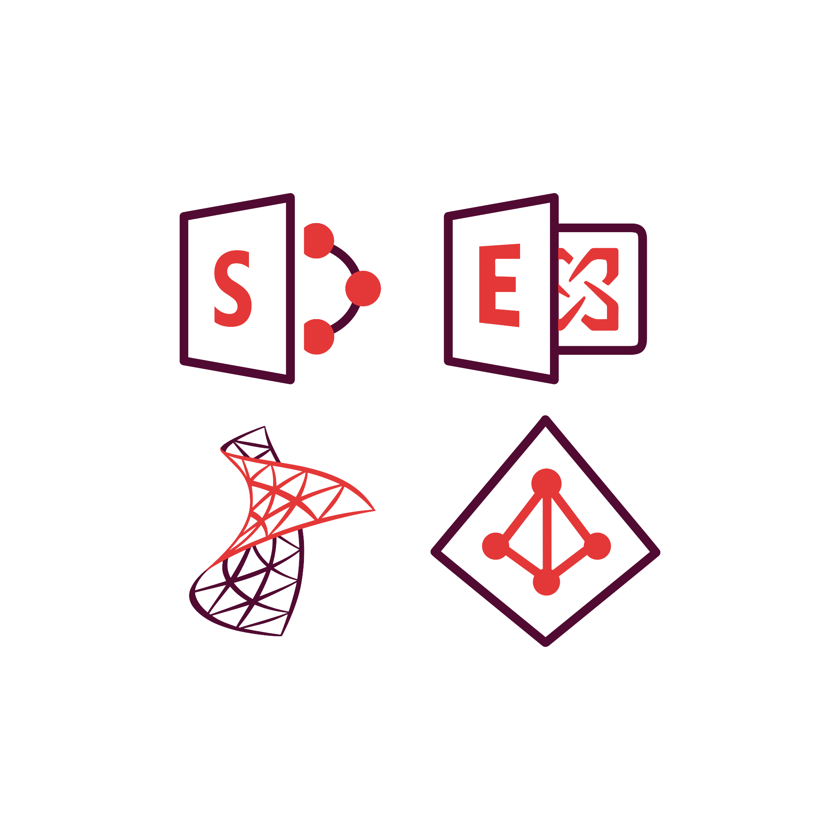


Restore the business-critical files/folders from the backed up data either from the Vembu BDR Client or from the BDR Backup Server.
Granular Recovery
LAN
Vembu BDR Client
Vembu BDR Backup Server
Application Recovery
Application Recovery
Backup & Disaster Recovery

Slide 21

Vembu Backup for Applications
Licensing Model

Slide 22
Licensing
Subscription
Available Editions
Vembu offers licensing options at monthly & yearly subscriptions
24/7 support and major/minor upgrades included
Standard
Perpetual
Paid Edition - Application Backup
One time purchase with upgrades and support free for one year
After 1 year AMC of 20% of license fee to be paid for continued support & updates
The granular backup and restore of applications, supports only Standard Edition, this edition holds the enterprise class functionalities in it.

Slide 23

Applications
Backup for
Applications
Subscription License
$60
(Includes product updates, upgrades & standard technical support until subscription period)
per Application/ annum
Perpetual License
$150
(Free maintenance & support for 1st year)
per Application
Backup & Disaster Recovery

Slide 24
Thank You
USA & CANADA
+1-512-256-8699
UNITED KINGDOM
+44-203-793-8668
Email
vembu-sales@vembu.com
vembu-support@vembu.com

