Slide 1



Slide 2




15+ Years
100+ Countries
60,000+ Businesses

Slide 3
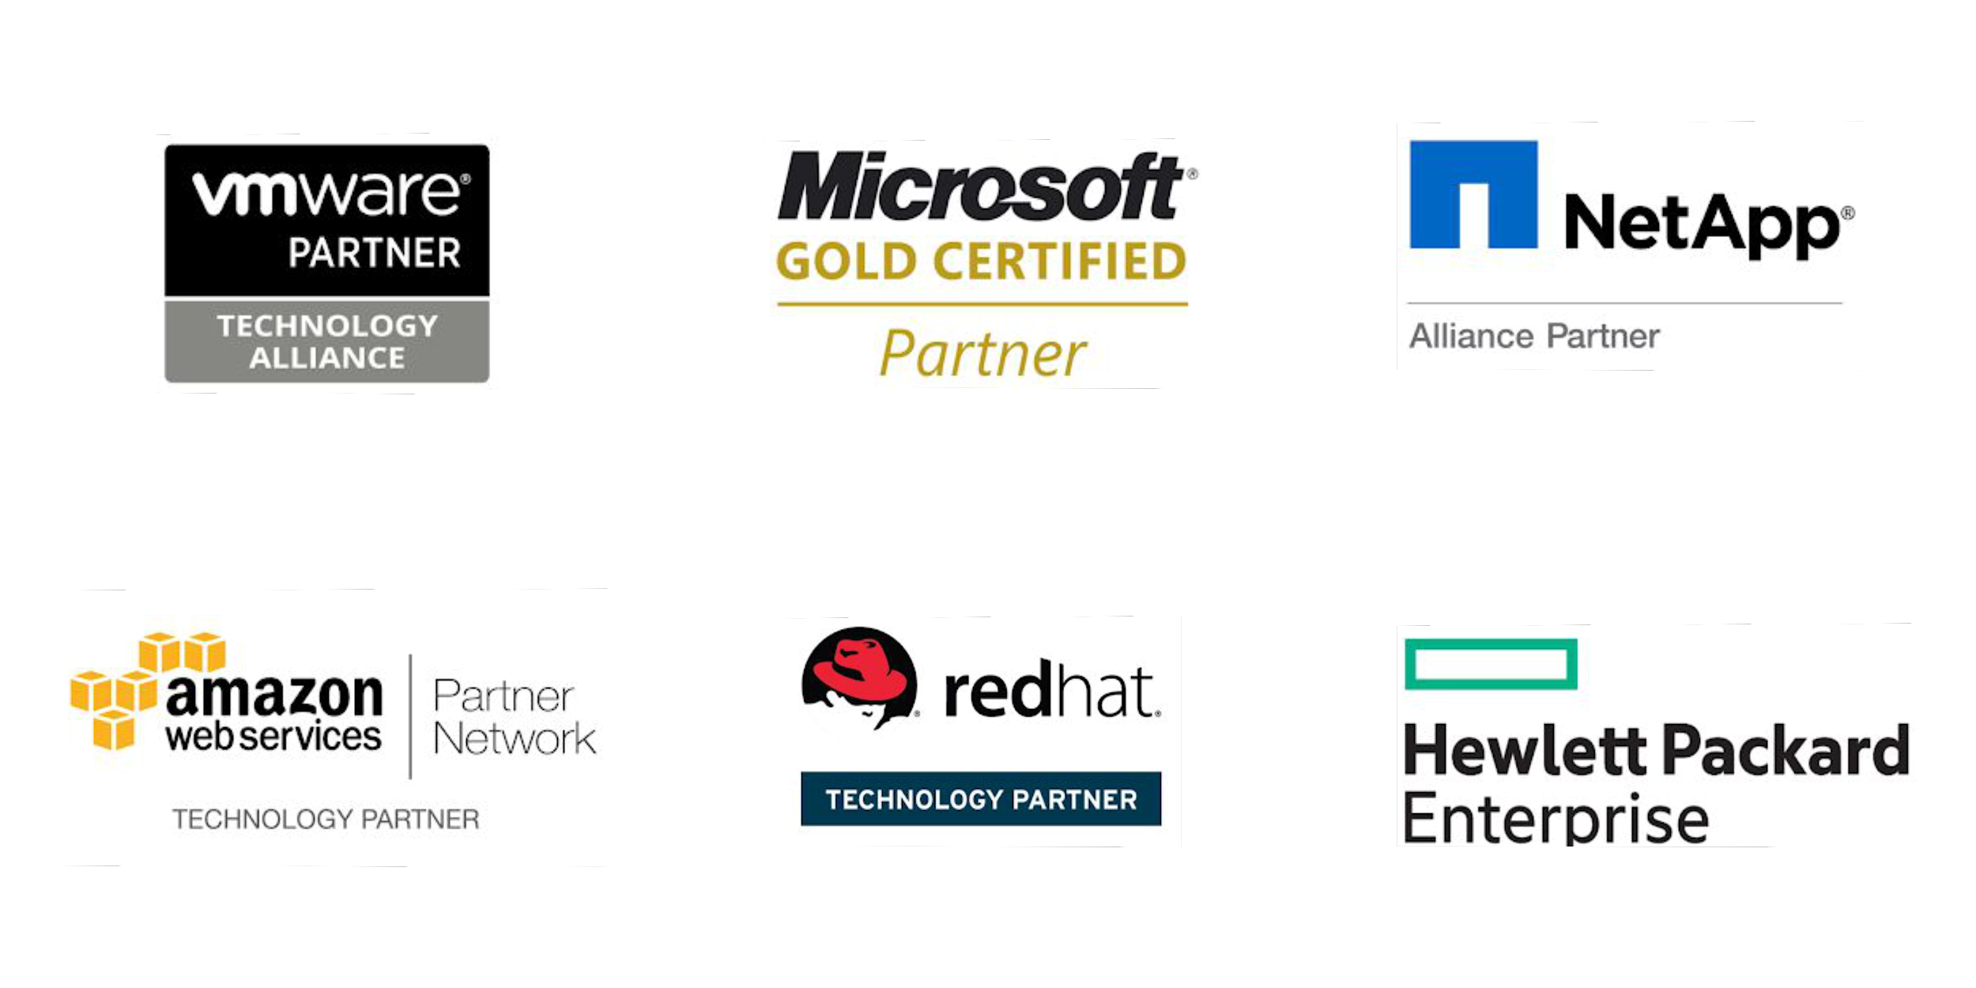
Vembu
Technology Partner

Slide 4
Vembu BDR Suite
Product Overview

Slide 5










Vembu BDR Suite
Vembu BDR Suite is a portfolio of products designed to backup multiple environments from
virtual to physical to cloud while addressing diverse and advanced use cases
Backup & Replication for VMware
Backup & Replication for Hyper-V
Backup for
Microsoft Windows
Backup for AWS
Backup for
Microsoft 365
Backup for
Google Workspace
Backup for
File Servers
Backup for Endpoints
Backup for
Applications

Slide 6
Vembu Backup & Replication
for VMware

Slide 7
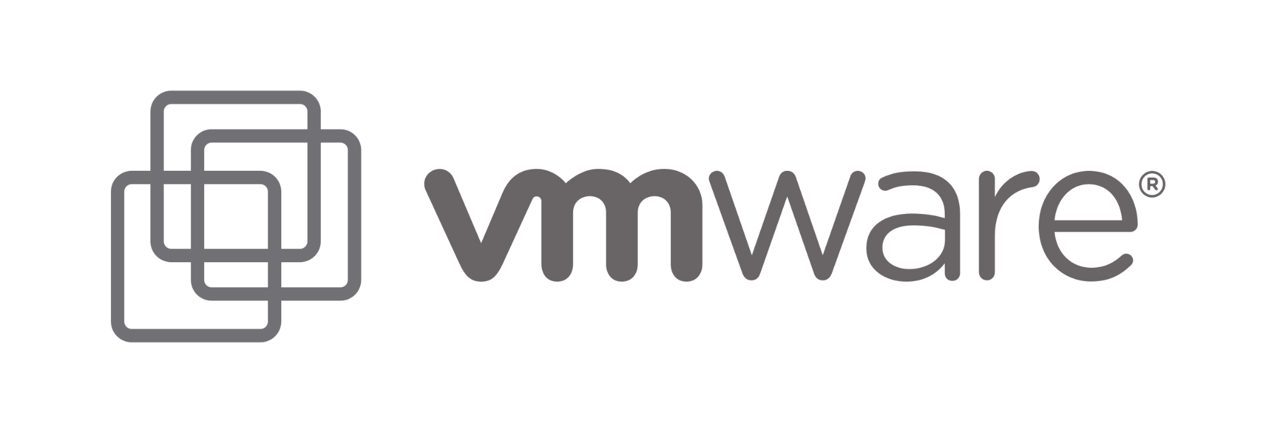
Vembu Backup & Replication for VMware delivers a powerful, flexible, and fully-featured backup solution that helps organizations to effectively meet the backup demands of their VMware vSphere environment.
Agentless Image-level VM Backup
VMware Replication for complete Site-level protection
VMware Changed Block Tracking for incremental backups
Backup & Replication for VMware
Backup & Disaster Recovery

Slide 8
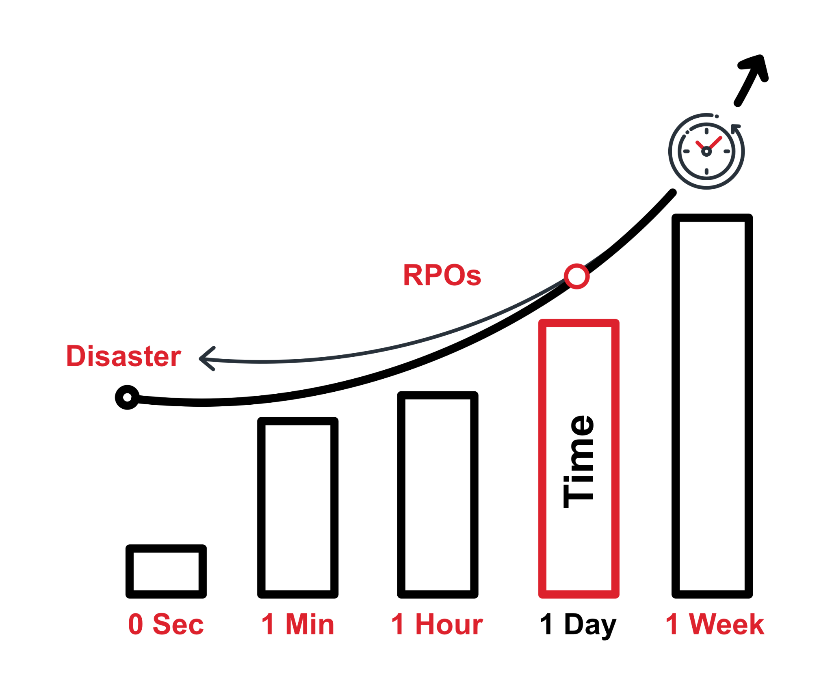
The RPO for your business can be set by the maximum amount of data that you can afford to loose if disaster strikes
With Vembu, you can also backup as frequently as every 15 minutes
You can also retain even years worth of data
Near Continuous Data Protection ensures that you don’t lose even minutes’ worth of data
Recovery Point Objective (RPO)
Backup & Disaster Recovery

Slide 9
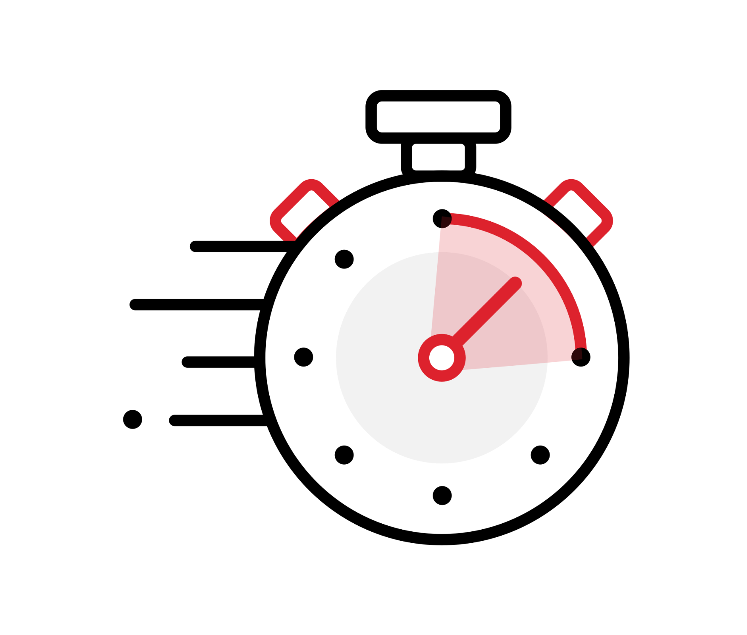
The time taken for a business to recover from the occurrence of a disaster is RTO
Downtime is not something every business can afford
With Vembu, you can recover your virtual machines within couple of minutes
Vembu adheres to the industries’ best RTO and RPO of <15 min
Recovery Time Objective (RTO)
Backup & Disaster Recovery

Slide 10
Vembu BDR Suite
Deployment

Slide 11
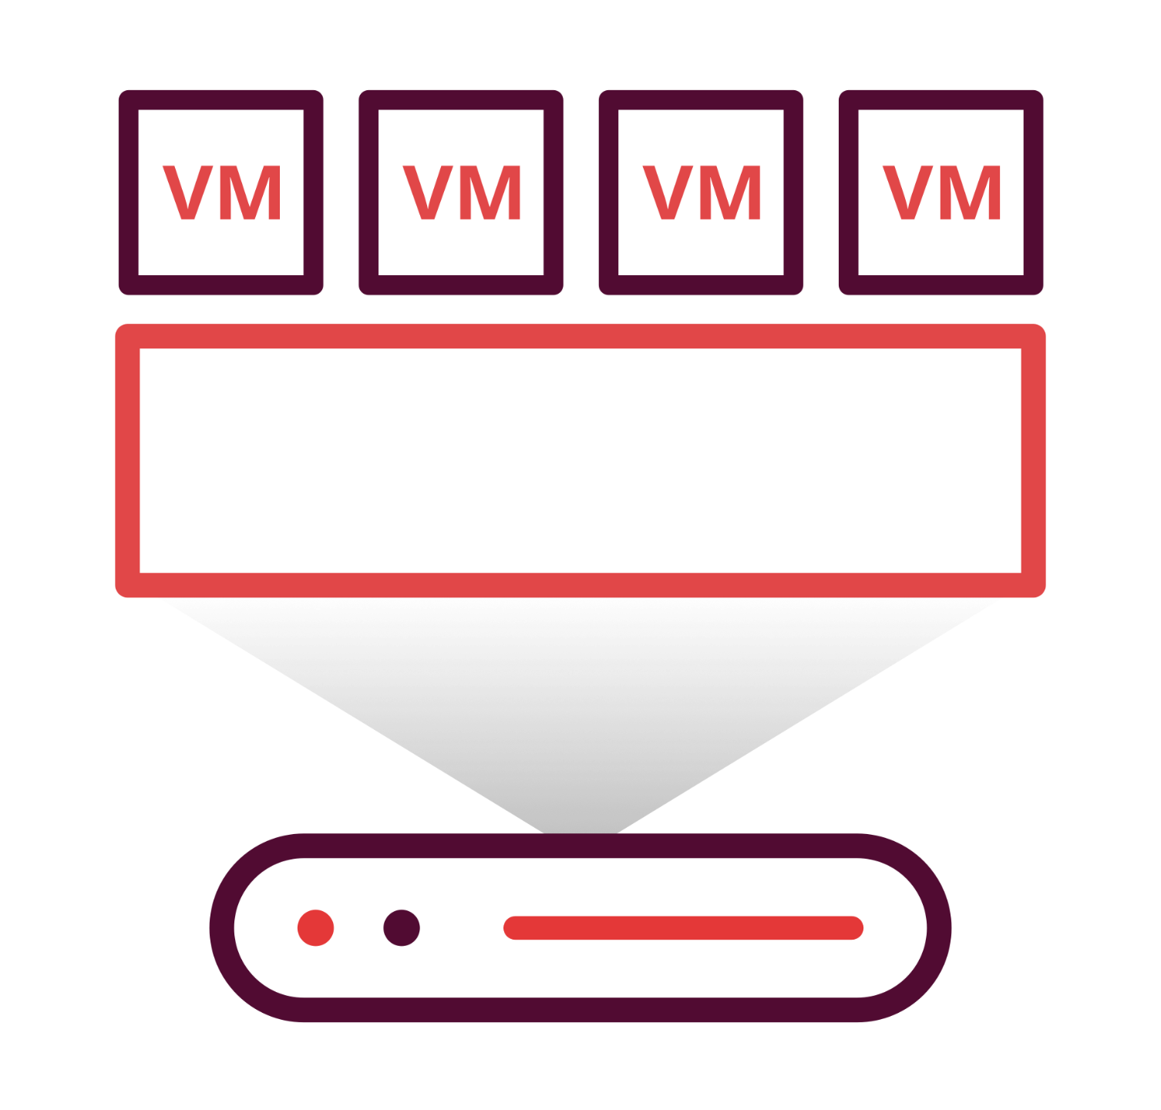
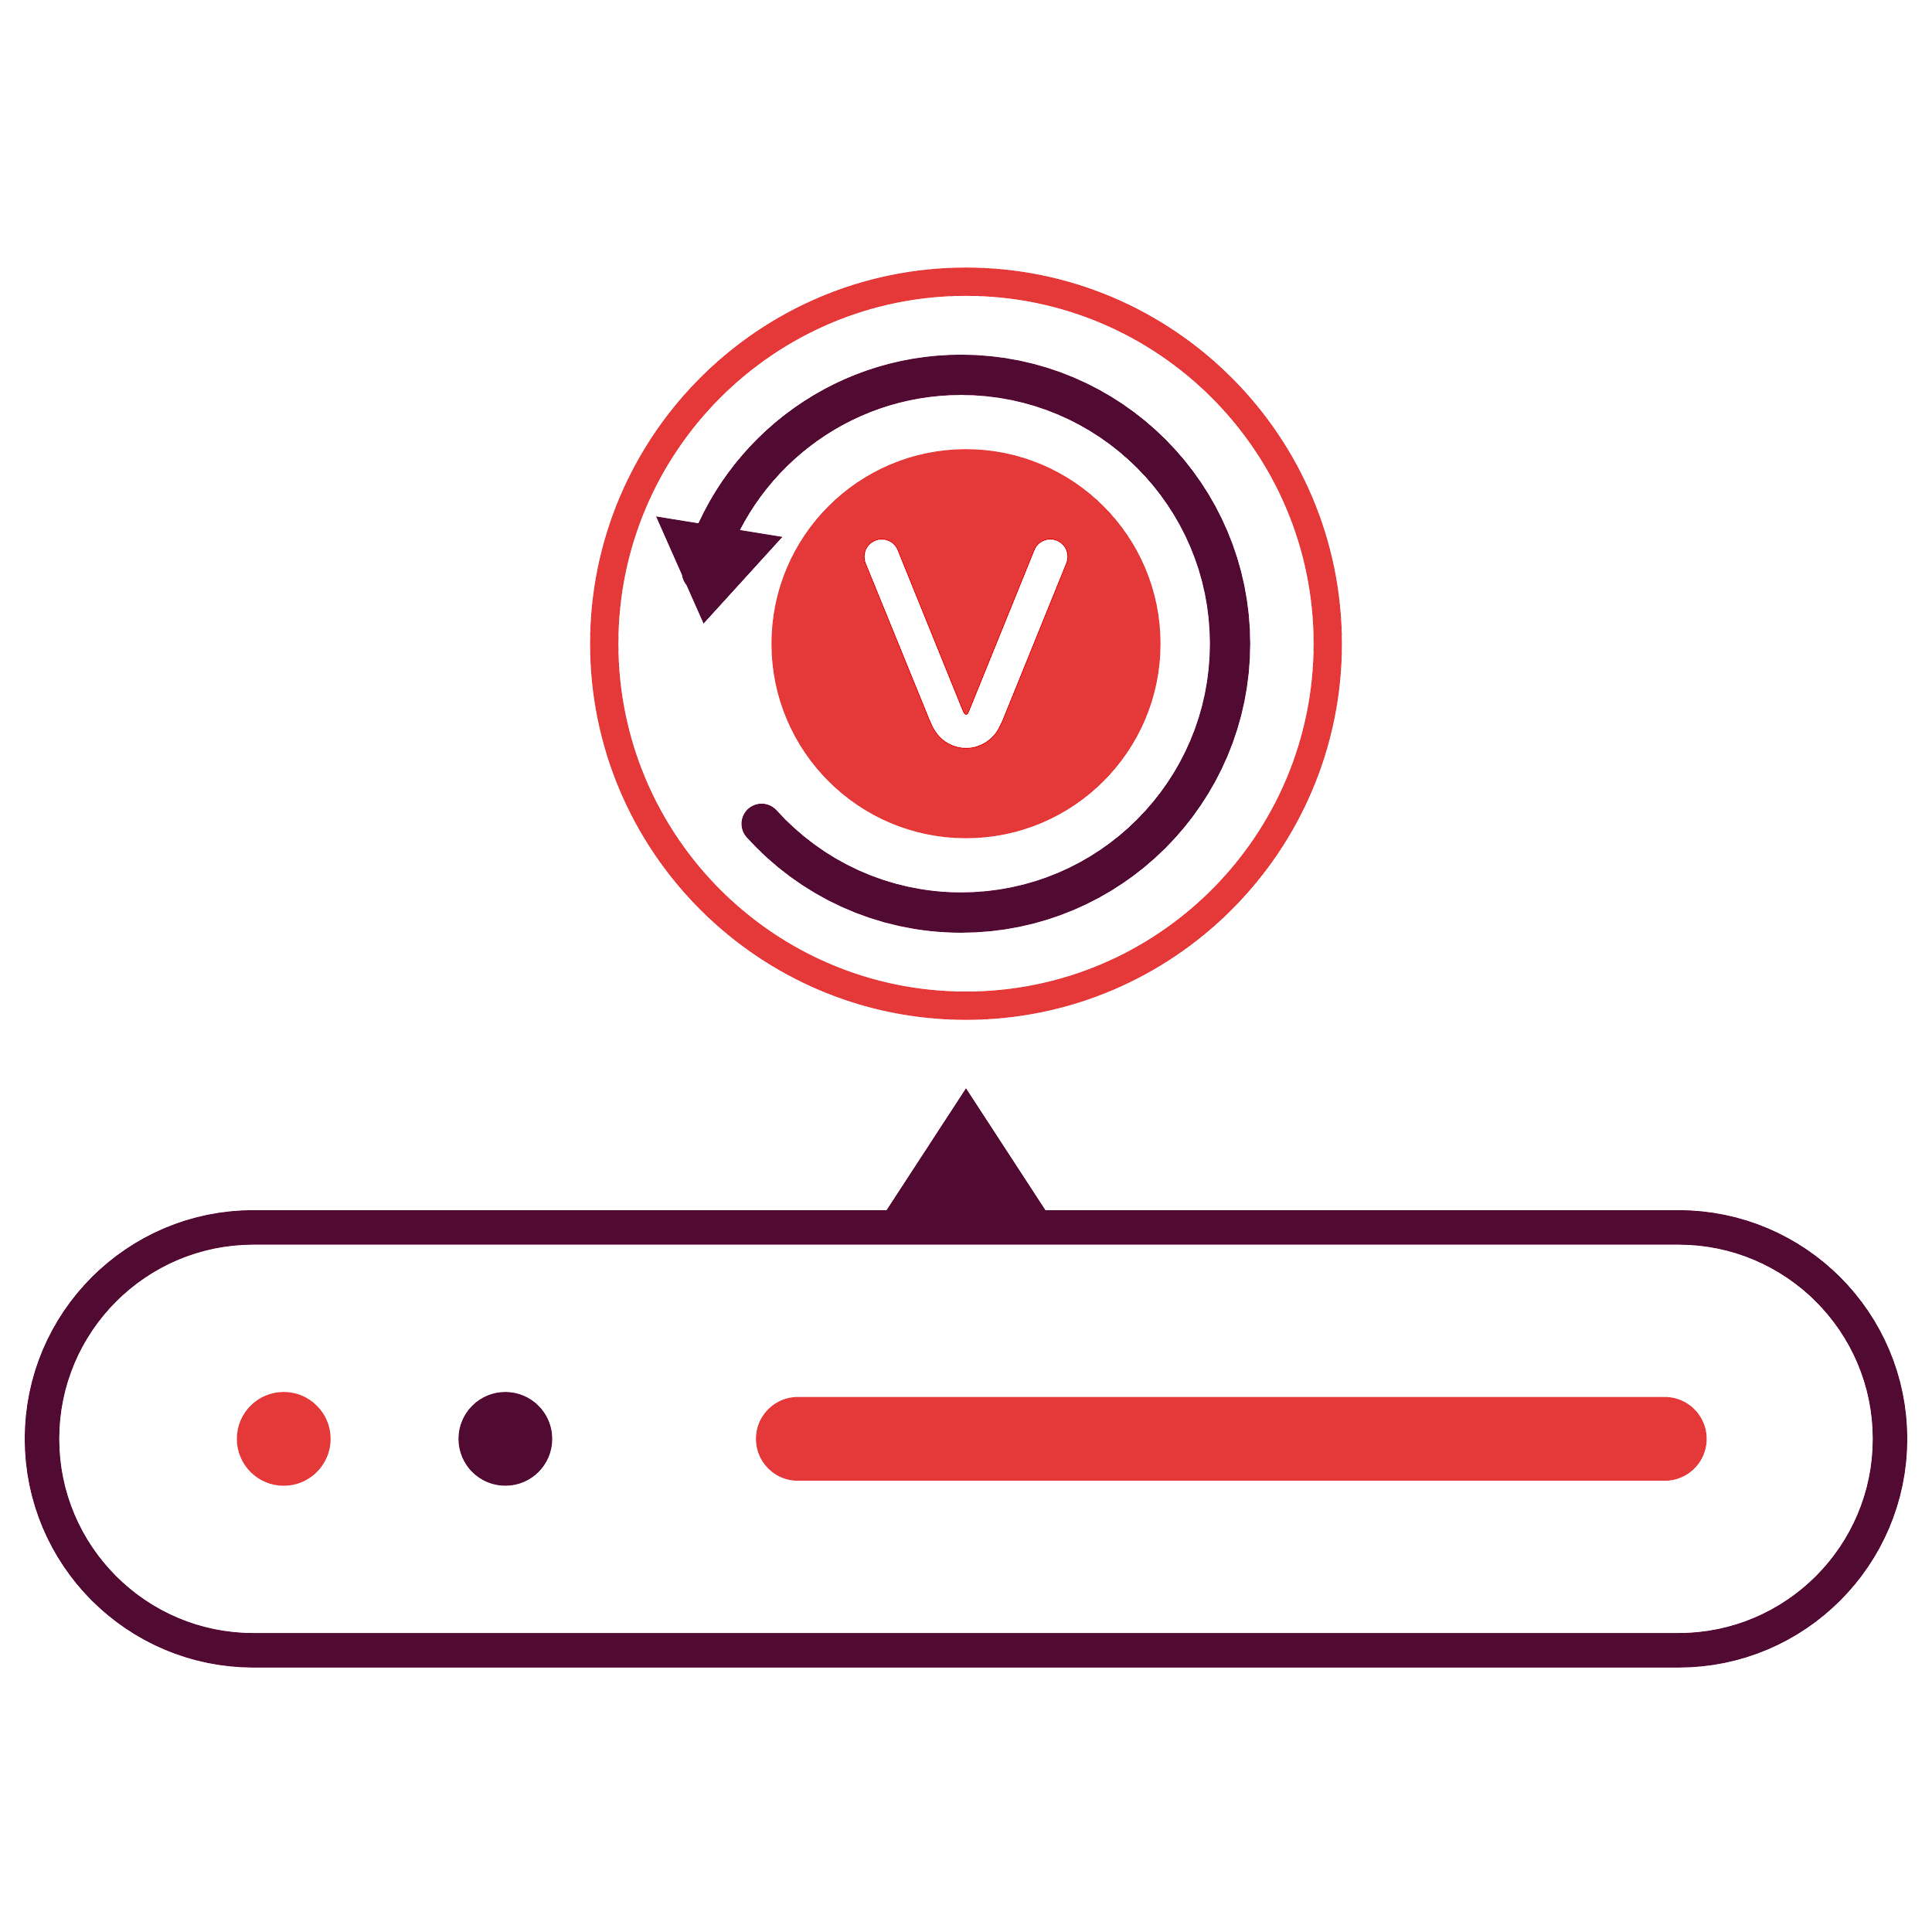
Ideal setup for businesses looking to manage backups within their premises
Setup BDR Backup Server in your local environment and backup via LAN
Configure and manage backup jobs from BDR Backup Server GUI
Backup VMs to the storage repositories attached to the backup server
On-premise Deployment - Simple
VMware
VMware APIs
Vembu BDR Backup Server
VMware
Backup & Disaster Recovery

Slide 12
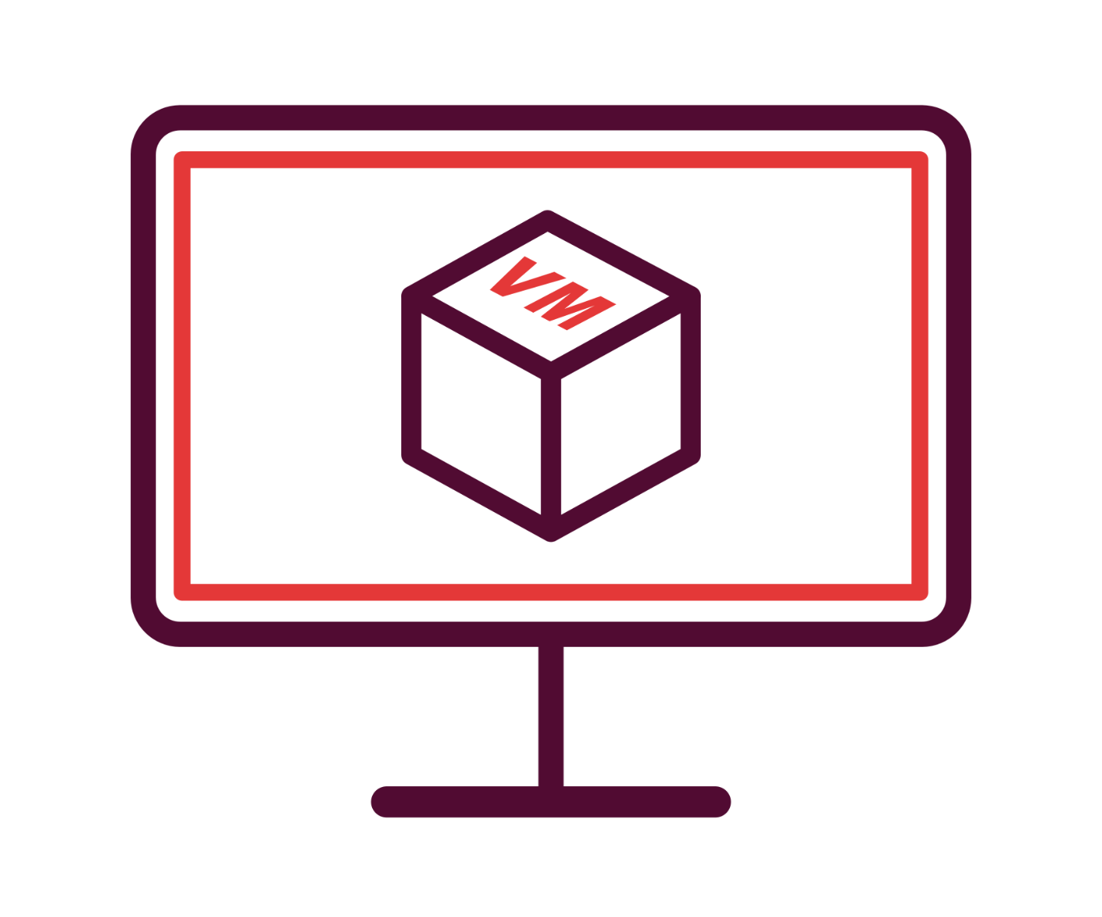
This deployment is recommended for large environments
Setup BDR Backup Server in your local environment and backup via LAN
Vembu BDR Client can be used to configure and manage backup jobs
Backup VMs to the storage repositories attached to the backup server
On-premise Deployment - Distributed
VMware
Vembu BDR Client
LAN
VM Backup
Vembu BDR Backup Server
VMware
Vembu BDR Client
Backup & Disaster Recovery

Slide 13
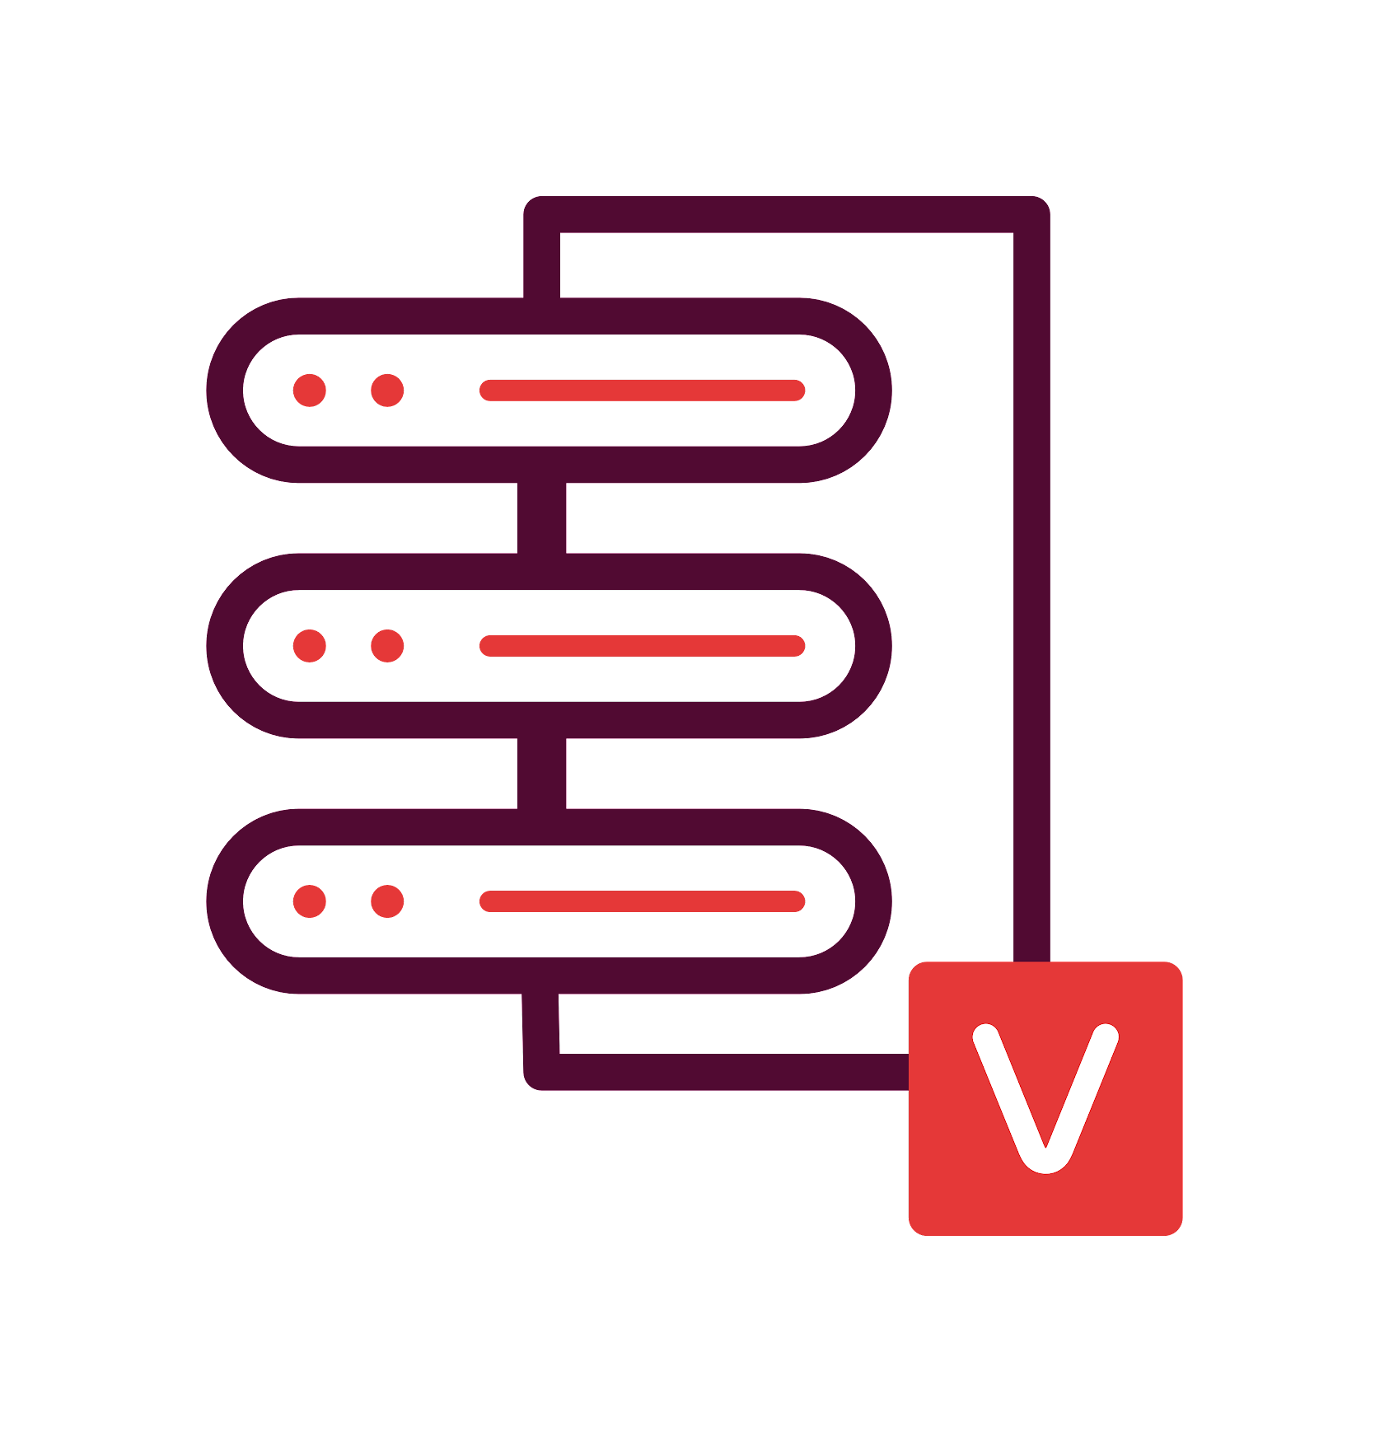
This deployment is recommended for large environments
Setup BDR Backup Server in your local environment and backup via LAN
Send a copy of backup data to your secondary datacenter via LAN/WAN
Ensure a disaster-resistant environment by installing the Vembu Offsite DR Server in your secondary datacenter
Hybrid Deployment Scenario 1 (Offsite DR)
VMware
LAN
LAN/WAN
Vembu BDR Backup Server
Vembu Offsite DR Server
VMware
Backup & Disaster Recovery

Slide 14
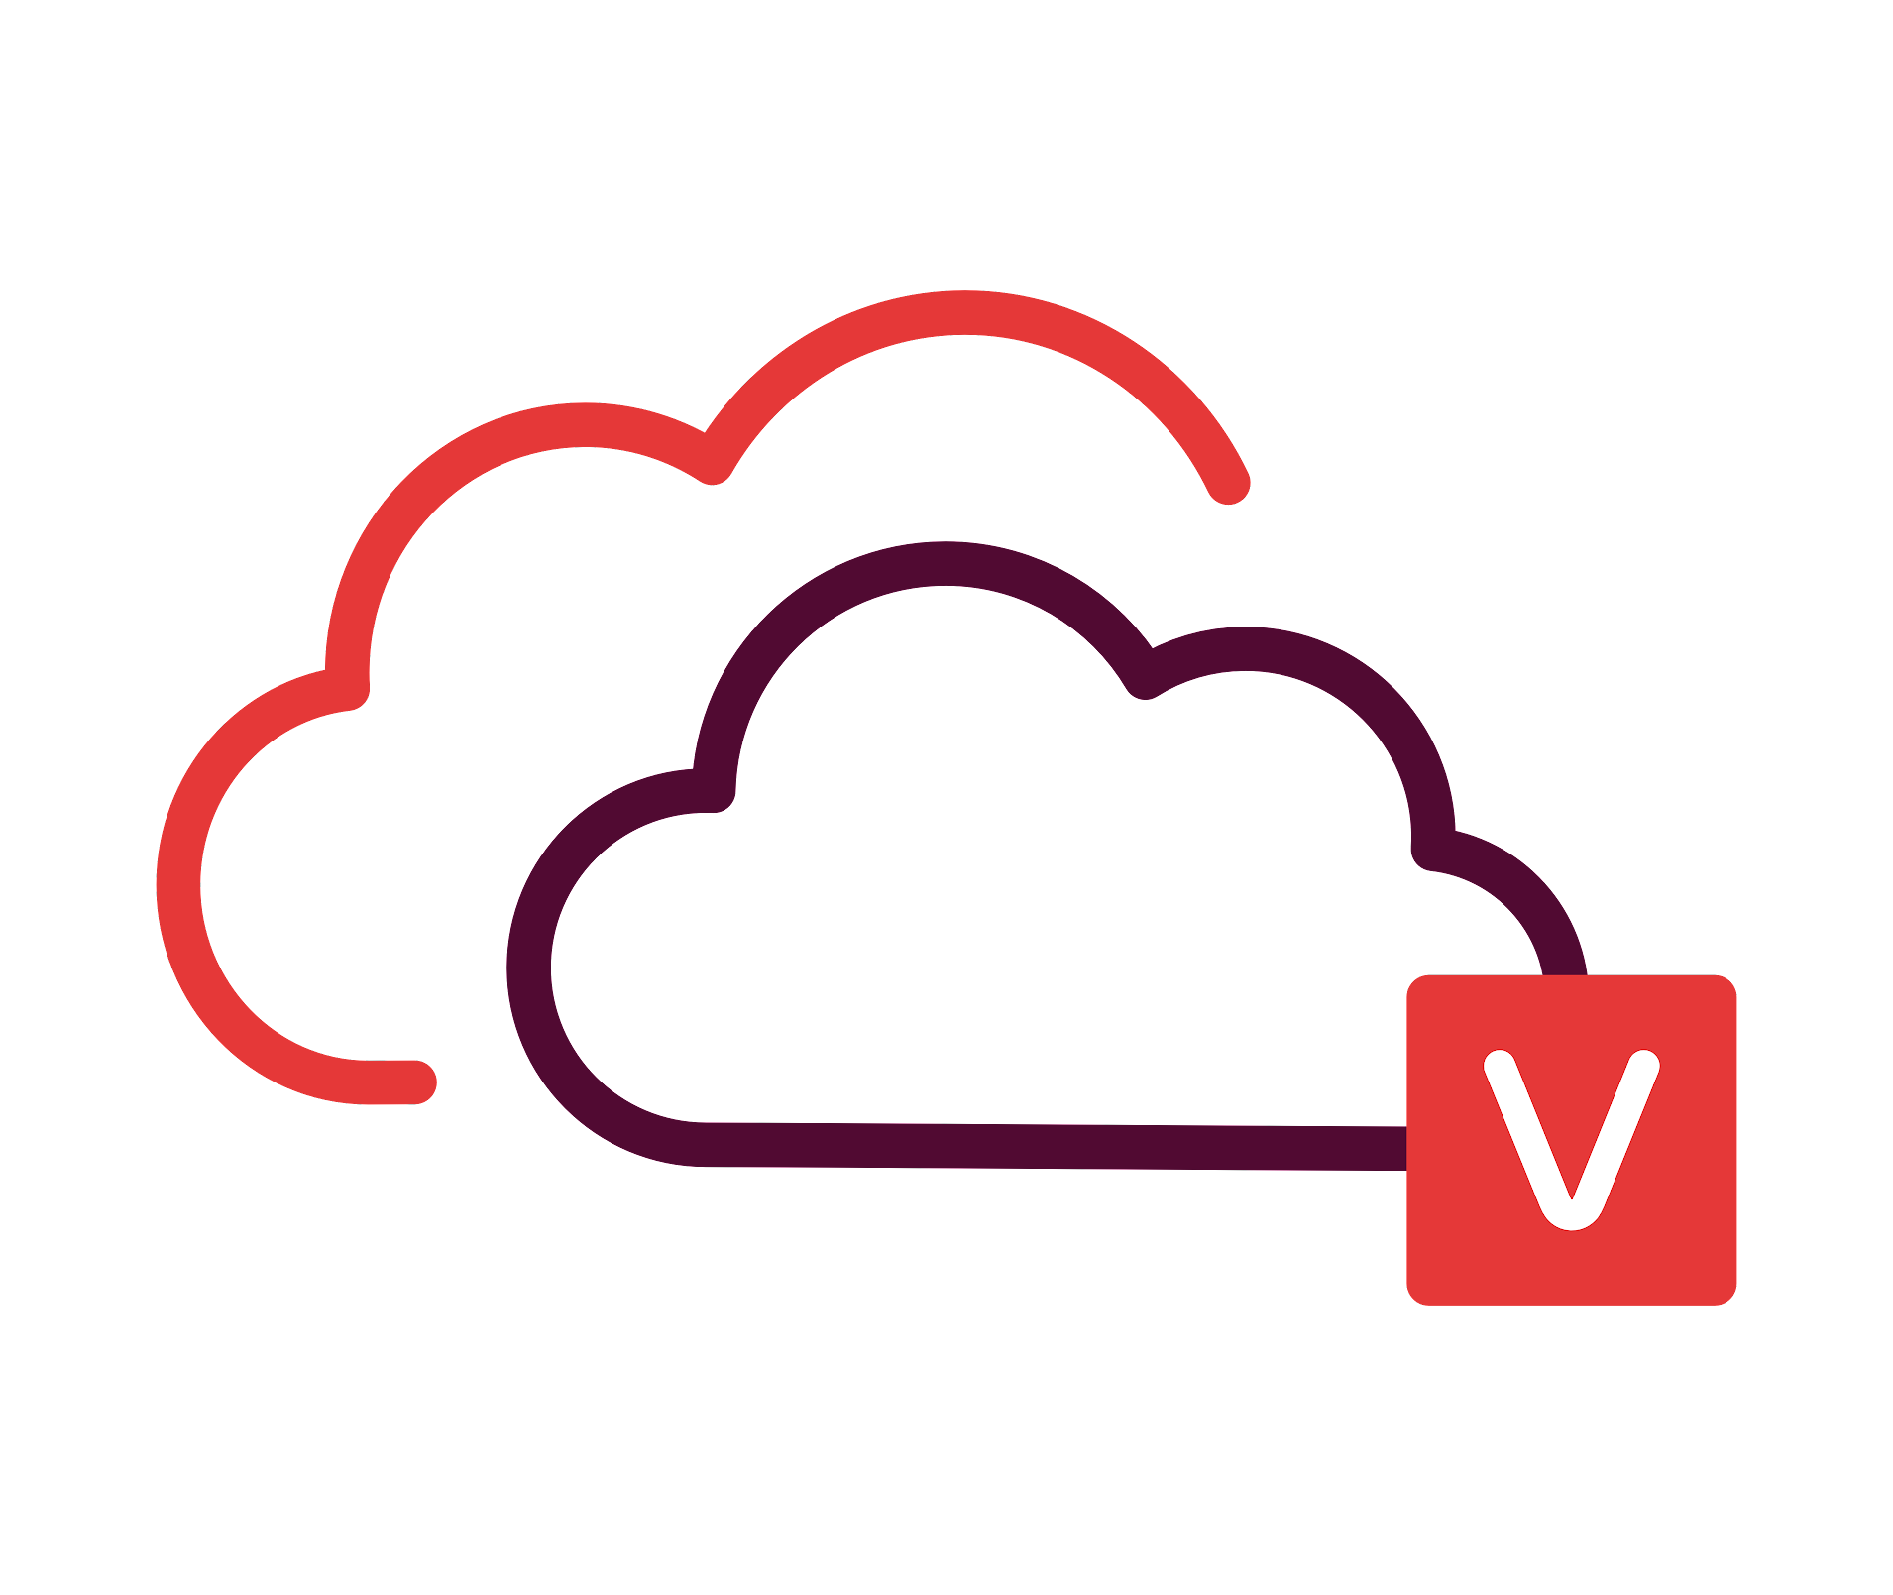
This deployment is recommended for small and medium environments
Setup BDR Backup Server in your local environment and backup via LAN
Send a copy of backup data to Vembu Cloud via WAN connection
Ensure a disaster-resistant environment by signing up for Vembu Cloud DR
Hybrid Deployment Scenario 2 (Cloud DR)
VMware
LAN
WAN
Vembu BDR Backup Server
Vembu Cloud DR Server
VMware
Backup & Disaster Recovery

Slide 15

Cloud Service Providers can host Vembu Offsite DR Server in their data center
They can have a copy of backup data from the Vembu BDR Backup Servers to their data center over WAN
Offsite (or) Remote Deployment (CSP)
Customer Site
Cloud Service Provider - Data Center
VMware
LAN
WAN
Vembu BDR Backup Server
Vembu Offsite DR Server
VMware
Backup & Disaster Recovery

Slide 16
Setup Vembu BDR Backup Server and Vembu Offsite DR Server in remote office as well as branch office
Sync backup data between both the locations
Remote office
Branch office
Vembu BDR Backup Server
Vembu Offsite DR Server
VMware
LAN
VMware
Vembu BDR Backup Server
Vembu Offsite DR Server
Backup & Disaster Recovery

Slide 17
You can easily scale up the backup server when backup load increases
Backup requests will be equally shared between each backup server
Backup Server
Clustering
Vembu BDR Backup Server
Vembu BDR Backup Server
VMware
Server Cluster
VMware
Vembu BDR Backup Server
Vembu BDR Backup Server
Backup & Disaster Recovery

Slide 18
Vembu BDR Suite
Key features

Slide 19







Key Backup & Replication Features of VMware Backup
Multi-host Backup
Parallel VM Processing
Failover & Failback VMs
Create a backup job with multiple-hosts and configure to run parallel thus improving backup performance.
Vembu now supports parallel backup of multiple VMs/disks in a single host
Vembu provides entire site-level protection by replicating business-critical VMs to a DR site and failover VMs at times of disaster also failback the same when things are normal.
Synthetic Full Backup
Native Tape Backup Support
Backup Job Template
Synthetic full backups are created in the backup repository by merging the full backup and all subsequent incremental backups in the backup repository itself
The frequently used backup configuration settings or as per some predefined backup policies, you can utilize these templates to create new backup jobs quickly.
Archive your backup data on tape drives for long-term retention.

Slide 20






Key Recovery Features of VMware Backup
RPO and RTO <15 mins
GFS Retention
Multiple Recovery Options
Minimize your downtime to less than 15 mins with quick VM recovery, disk mounts & granularly recover file/apps.
GFS retention helps to create restore points on a weekly, monthly, quarterly, and yearly basis.
Multiple restore options helps to restore the backup data granularly, perform cross-platform migration, instantly boot as VM, Download in various file-formats and also perform Bare-Metal Recovery
Instant Boot Live Migration
Applications item-level Recovery
Reliable Backups
A permanent migration process where the virtual/ physical machine backup that is instantly booted as VM can be migrated as an independent VM to a targeted VMware Host.
Granularly restore Microsoft applications at item level directly from the BDR Backup Server web GUI
Automated 3-tier backup verification – boot, mount & data integrity tests to ensure recoverability data.

Slide 21






Other Key Features of VMware Backup
Efficient Storage Management
Compression
Backup Level encryption
Vembu BDR Backup Server utilizes VembuHIVE™ file system to effectively manage storage repositories..
Built-in compression and deduplication to reduce the storage space with the ability to scale as & when required.
Use system-generated passwords or add your own, to encrypt the backup data using AES-256 bit encryption algorithm.
Drive Rotation
Where it left off
Reporting
It helps you to use multiple external hard drives to store the backup data and swap them on a regular basis.
Even if there is a network failure or other interruptions during backup, the backup will automatically restart from where it left off during the previous schedule
Users can manage all their backups with Backup Status Reports, VM Status Reports, Integrity Report and Restore Report

Slide 22
Vembu BDR Suite
VMware Backup Transport Modes

Slide 23

Vembu Client for VMware Backup should have access to the SAN. It works on both physical server/FC or VM/iSCSI
The Vembu Client for VMware Backup directly reads the data to be backed up from the SAN
It sends them to the storage repositories in the Vembu BDR Backup Server
Direct SAN Transport Mode
Metadata Request
VMware
Metadata Response
Vembu BDR Backup
Server
Data Transfer
SAN
Backup & Disaster Recovery

Slide 24

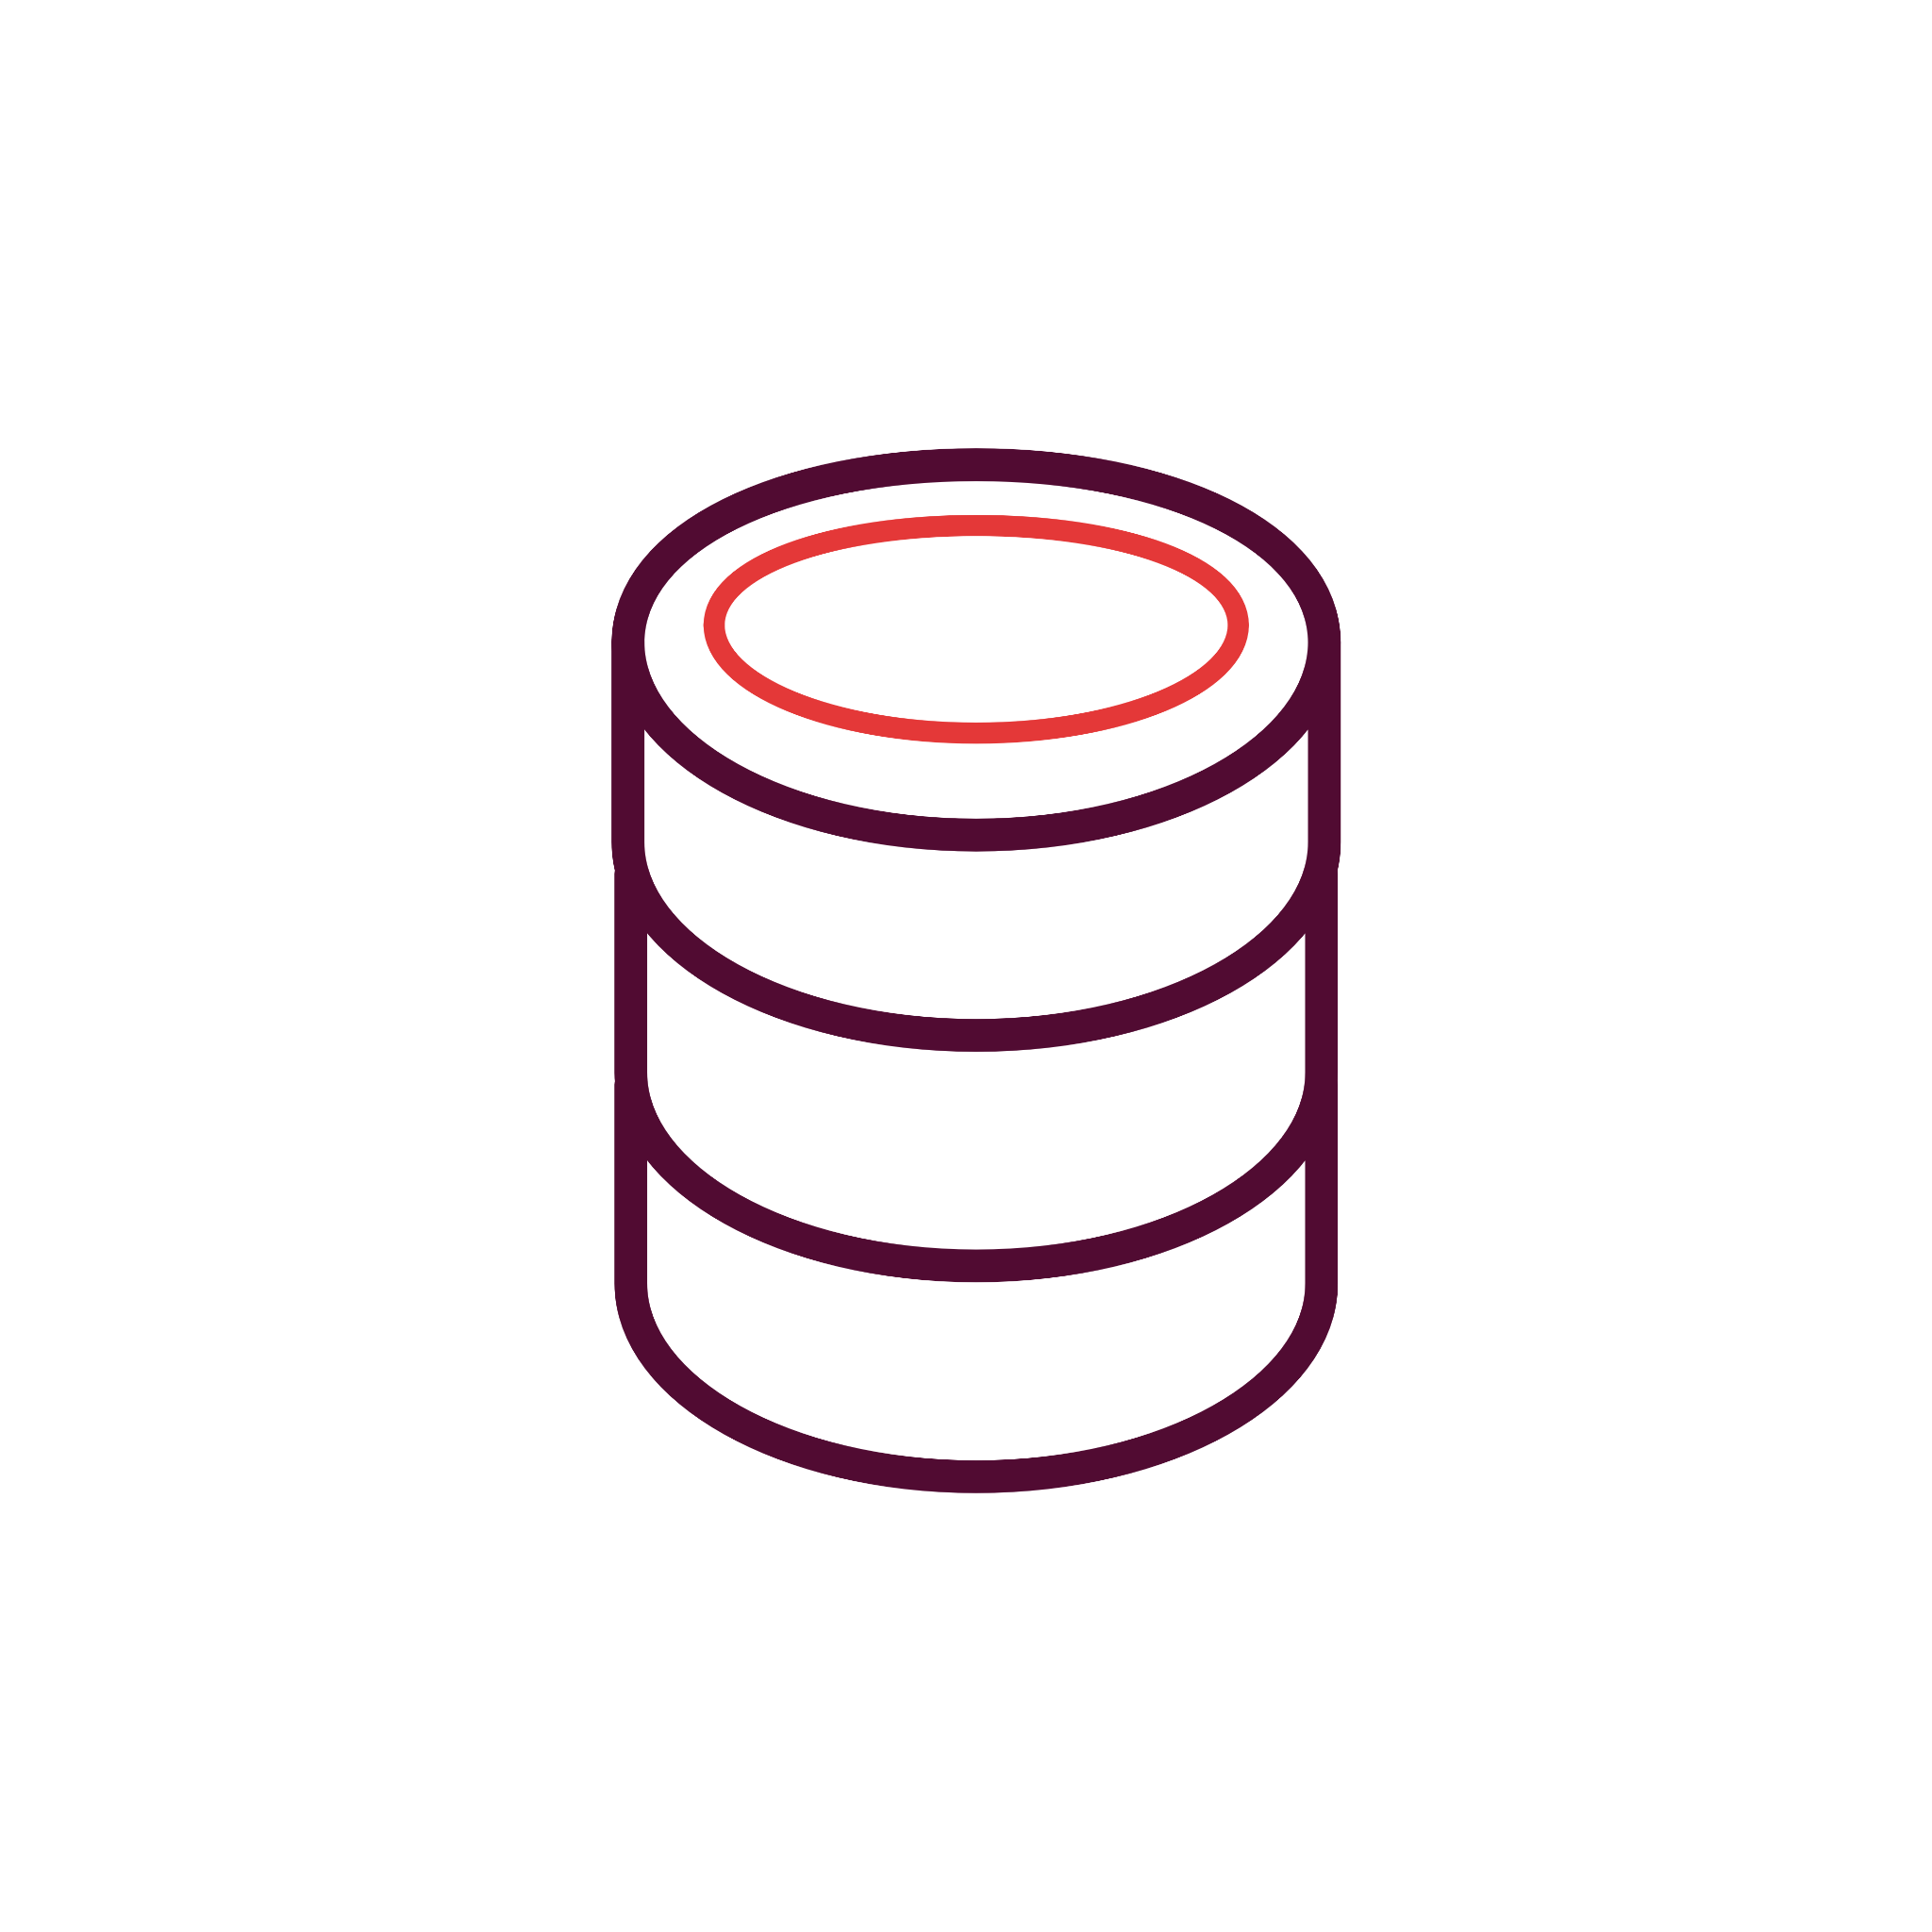
Vembu Client for VMware Backup needs to be installed on a physical or virtual machine
The ESXi host sends the data to the client, from the client it is sent to the storage repository
The Vembu Client will read the attached disks and send the data to the backup server storage repositories
vCenter Server
Hot-Add
Transport Mode
VMware
Request
Vembu BDR Backup Server
VMware
Vembu Virtual Drive
Datastore
Backup & Disaster Recovery

Slide 25
Vembu Client for VMware Backup can be either installed on a physical or virtual machine
The virtual disk of the VM to be backed up can be directly attached to the VM that hosts the Vembu Client
The data transfer speed will be lower than the other two modes
vCenter Server
Network
Transport Mode
VMware
Request
Response
VMware
Vembu BDR Backup Server
Datastore
Backup & Disaster Recovery

Slide 26
Vembu BDR Suite
Disaster Recovery Scenarios

Slide 27
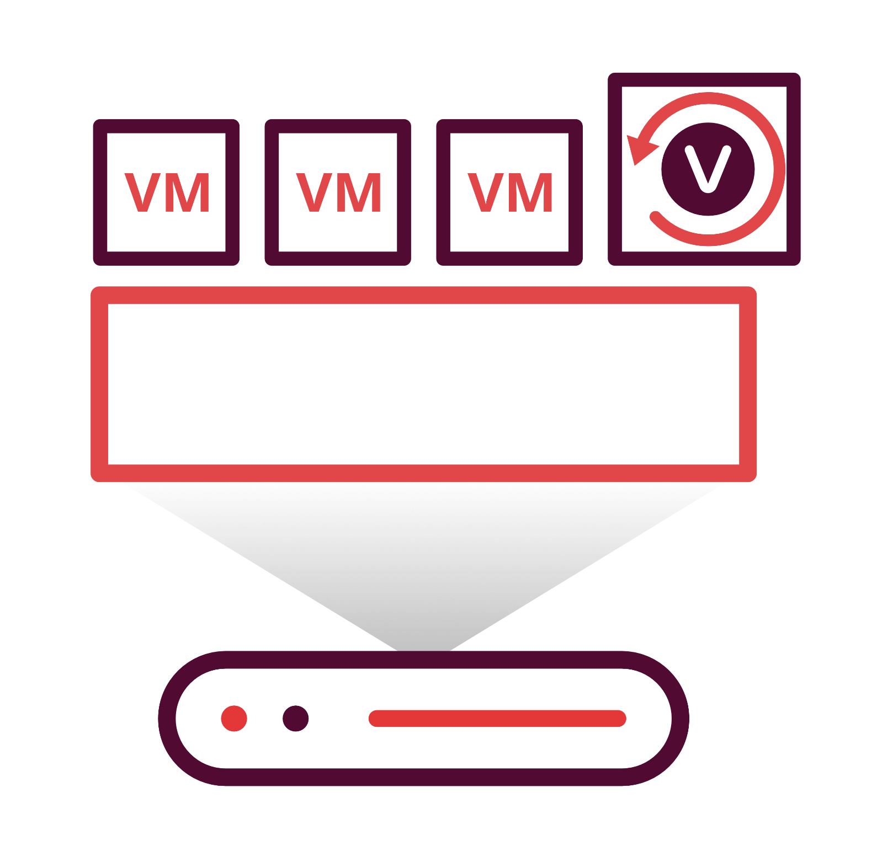
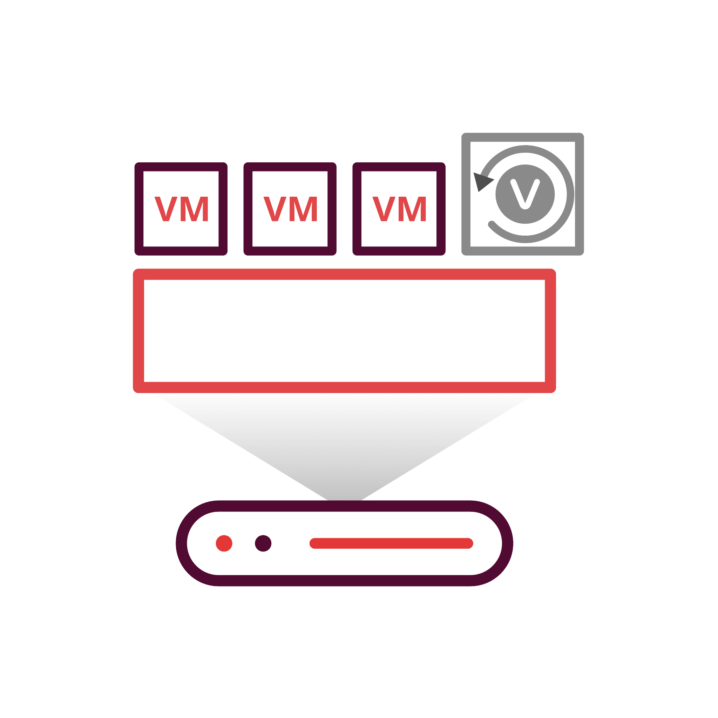
Instantly boot the backed up data as a ready state VM on VMware/ Hyper-V/ KVM hypervisors by mounting the data through Vembu Virtual Drive
VMware
Instant Boot VM Recovery
VMware
Hyper V
Vembu BDR Backup Server
Vembu Virtual Drive
KVM
Backup & Disaster Recovery

Slide 28
Restore the backed up VM permanently to the same or different VMware ESXi host
Full VM Recovery
VMware
VMware
VMware
Vembu BDR Backup Server
Backup & Disaster Recovery

Slide 29

Restore the selected disk/disks of a backed up VMware VM to the same VM or different VM running on VMware host.
Disk Level Recovery -Vmware
VMware
VMware Backup
Vembu BDR Backup Server
Backup & Disaster Recovery

Slide 30


Restore files/folders from the backed up VM instantly without having to restore the entire backed up VM
File Level Recovery
VMware
Vembu BDR Backup Server
File / Folder- level recovery
Backup & Disaster Recovery

Slide 31
Instantly boot the replicated VM from the target ESXi host when your source VM is down.
Failed over VM can later be Failed Back to the source ESXi host or different host
Failback
Failover
VMware Replication
Failover & Failback
VMware
VMware
Backup & Disaster Recovery

Slide 32
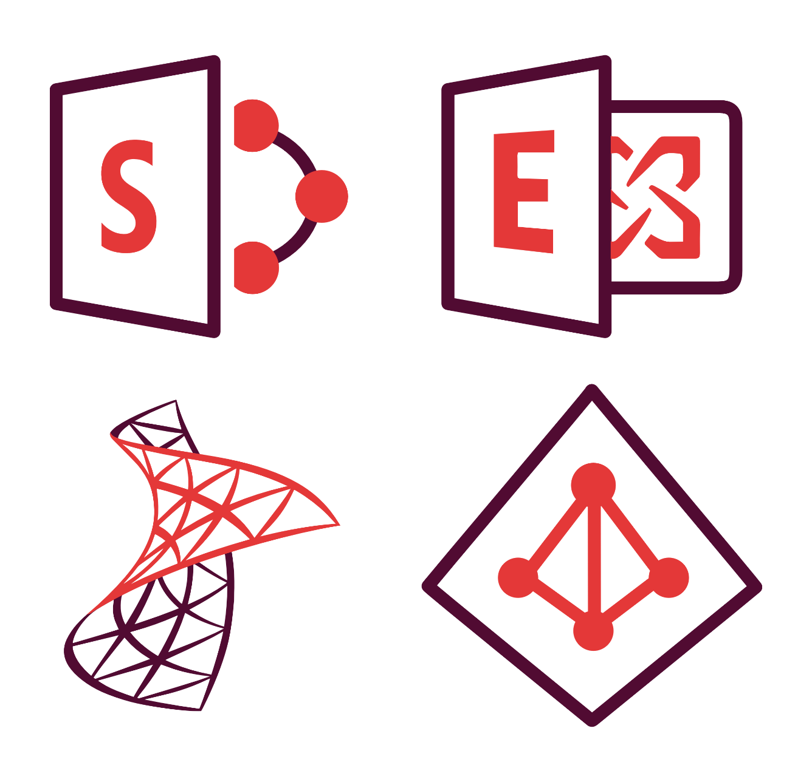
Vembu helps you to restore Microsoft applications i.e. MS Exchange mails, MS SQL database/tables, MS SharePoint documents and MS AD Users/Roles granularly
Application Item Level Recovery
VMware
VM Backup
Vembu BDR
Backup Server
Vembu
Virtual Drive
Backup & Disaster Recovery

Slide 33
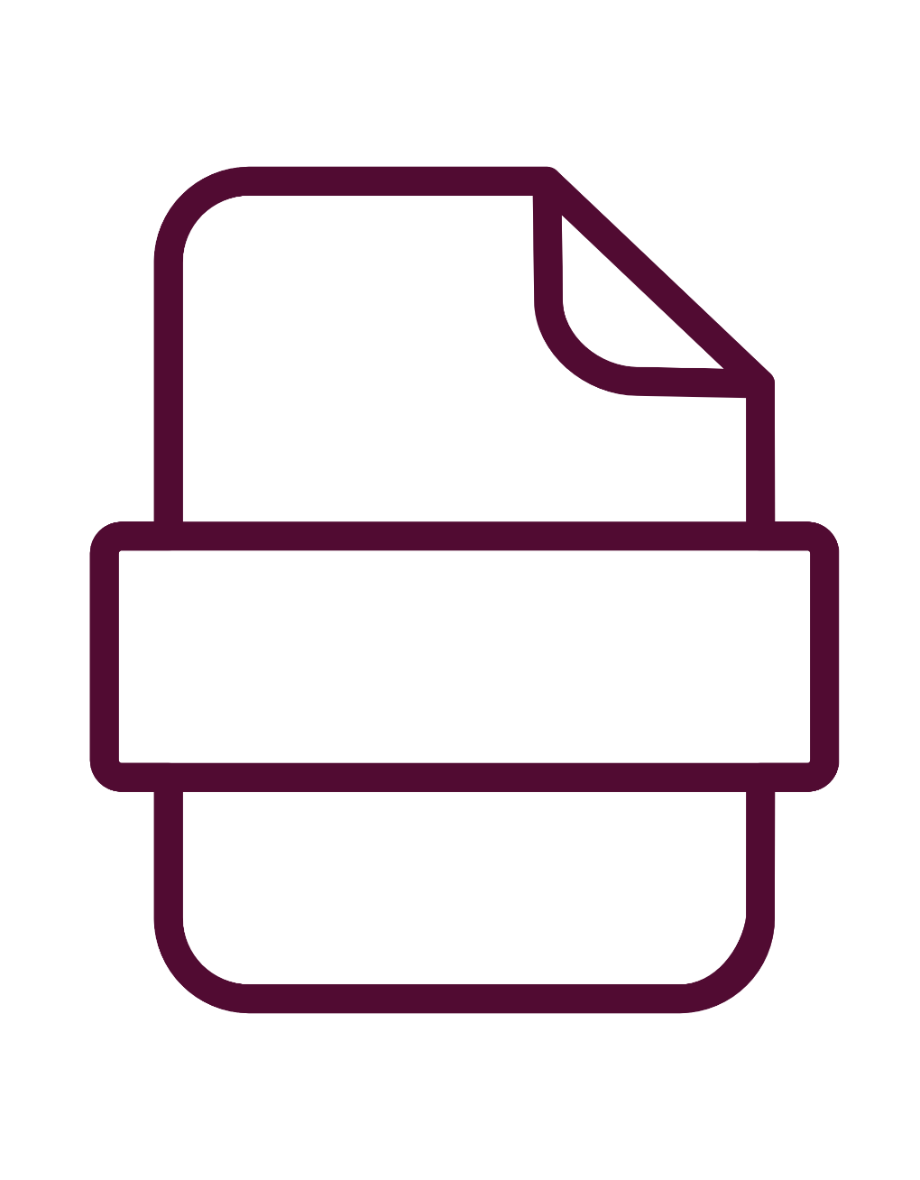
Vembu Virtual Drive in Vembu BDR Backup Server stores the backup data in neutral file formats i.e. IMG, VHD, VHDX, and VMDK; with the help of the VembuHIVETM file system
For every incremental schedule, full virtual hard disk files will be created without using any additional storage
Vembu
Virtual Drive
VMware
VM Backup
VHD/VHDX
VMDK
RAW
VMware
Vembu BDR
Backup Server
Vembu
Virtual Drive
Backup & Disaster Recovery

Slide 34

Vembu Backup & Replication for VMware Licensing Model

Slide 35
Licensing
Subscription
Available Editions
Vembu offers licensing options at monthly & yearly subscriptions
24/7 support and major/minor upgrades included
Free
Standard
Enterprise
Perpetual
Essentials Package
Essentials includes the same functionality as that of respective paid editions and is available only for businesses (SMBs & Midrange) with up to 10 CPU-Sockets or 100 VMs.
One time purchase with upgrades and support free for one year
After 1 year AMC of 20% of license fee to be paid for continued support & updates

Slide 36

Standard
Essentials
EnterpriseEssentials
Standard
Enterprise
Upto 10 sockets or
100 VMsv
Upto 10 sockets or 100 VMs
Subscription License: Includes product updates, upgrades and standard technical support during the subscription period
CPU Socket level pricing
$108
$216
$180
$360
Backup & Replication for VMware
per cpu-socket/annum
per cpu-socket/annum
per cpu-socket/annum
per cpu-socket/annum
VM level pricing
$18
$36
$30
$60
per vm/annum
per vm/annum
per vm/annum
per vm/annum
Perpetual License: Free maintenance & support for 1st year
CPU Socket level pricing
$270
$540
$450
$900
per cpu-socket
per cpu-socket
per cpu-socket
per cpu-socket
VM level pricing
$45
$90
$75
$150
per vm
per vm
per vm
per vm
Backup & Disaster Recovery

Slide 37
Thank You
USA & CANADA
+1-512-256-8699
UNITED KINGDOM
+44-203-793-8668
Email
vembu-sales@vembu.com
vembu-support@vembu.com

